Slide 1
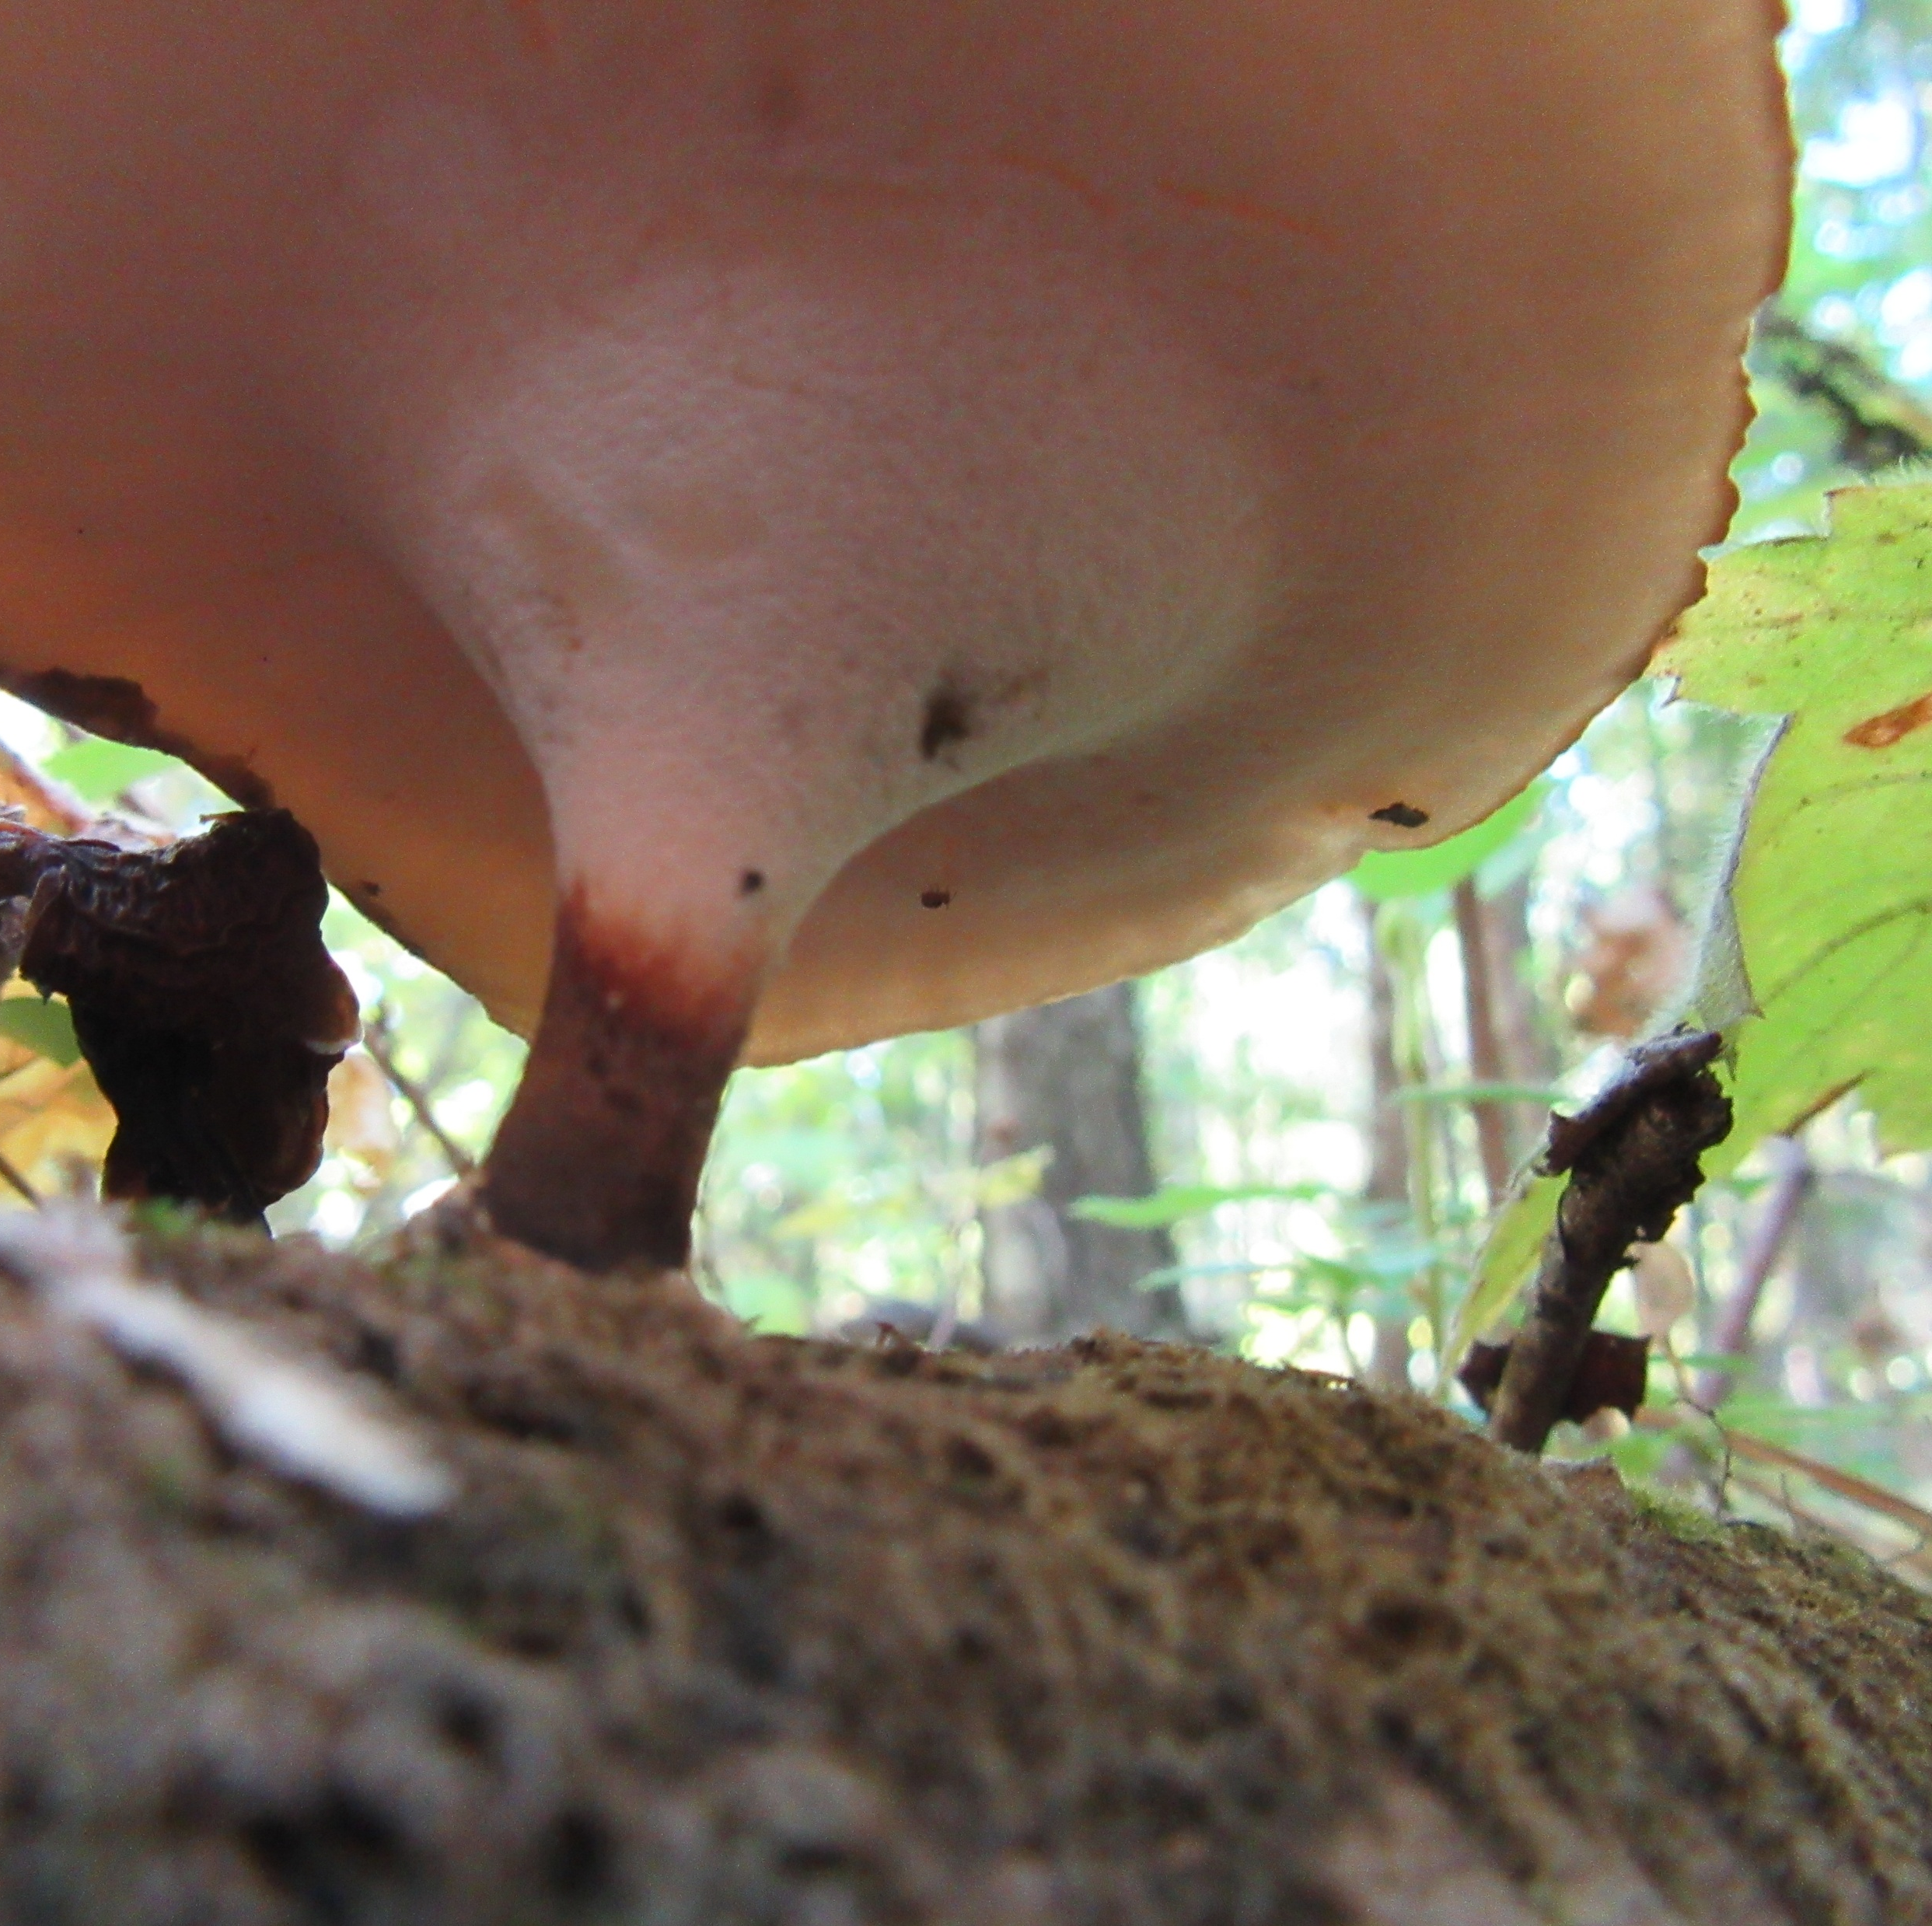
Forest Under Stress | Respiration & Filtered Sunlight- Rachel Lee Hall
This photo review of a thinned mixed conifer-deciduous forest includes prescribed burning after treatment. All photos with one exception were taken by Rachel Lee Hall in the Rogue River-Siskiyou National Forest of Southern Oregon. Animation by Forest Under Stress (FUS).
Crown fires in the pipeline are waiting for ignition. Upon ignition a complete loss of DNA legacy stored in the elder, mother, old growth and secondary growth trees would be lost when crown fires occur. These forest wildfires are not the forest fires of the historical past. They climb scaffolding quickly to the crown racing across the forest canopy at extreme temperatures with far reaching advancing embers destroying forest landscapes and all that exists therein including communities.
There is a national disaster occurring in our NF.

Slide 2
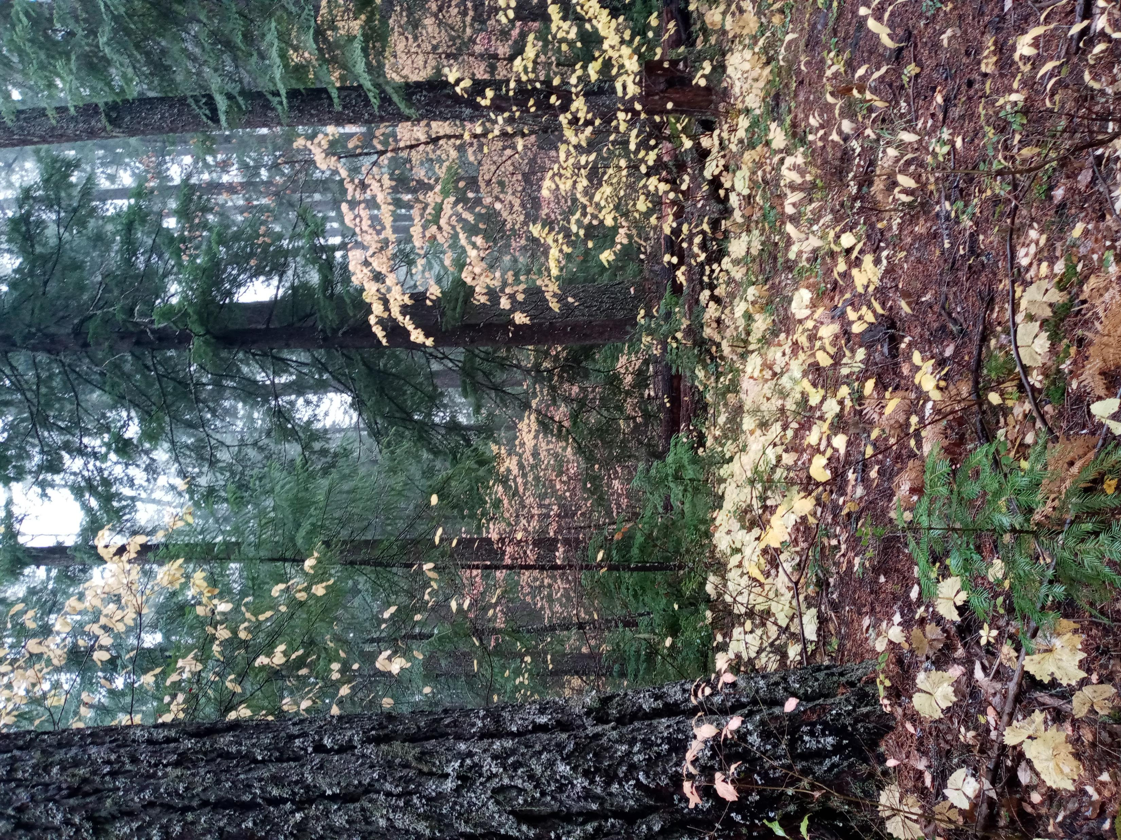
Filtered sunlight is critical for a healthy forest floor and maximum respiration--the forest breathing apparatus in the terrestrial story.

Slide 3
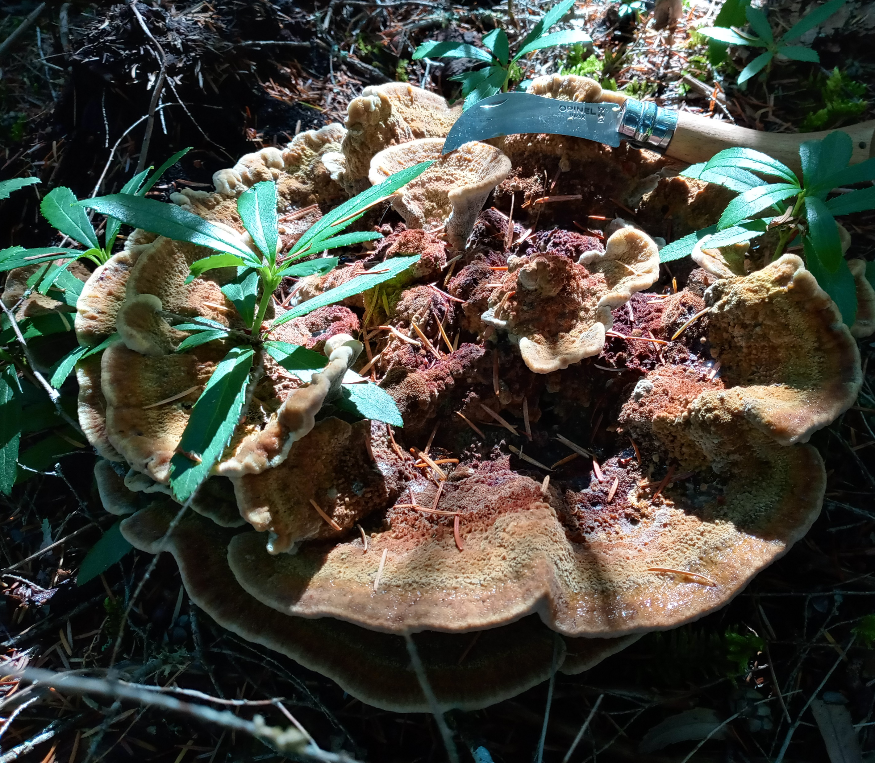
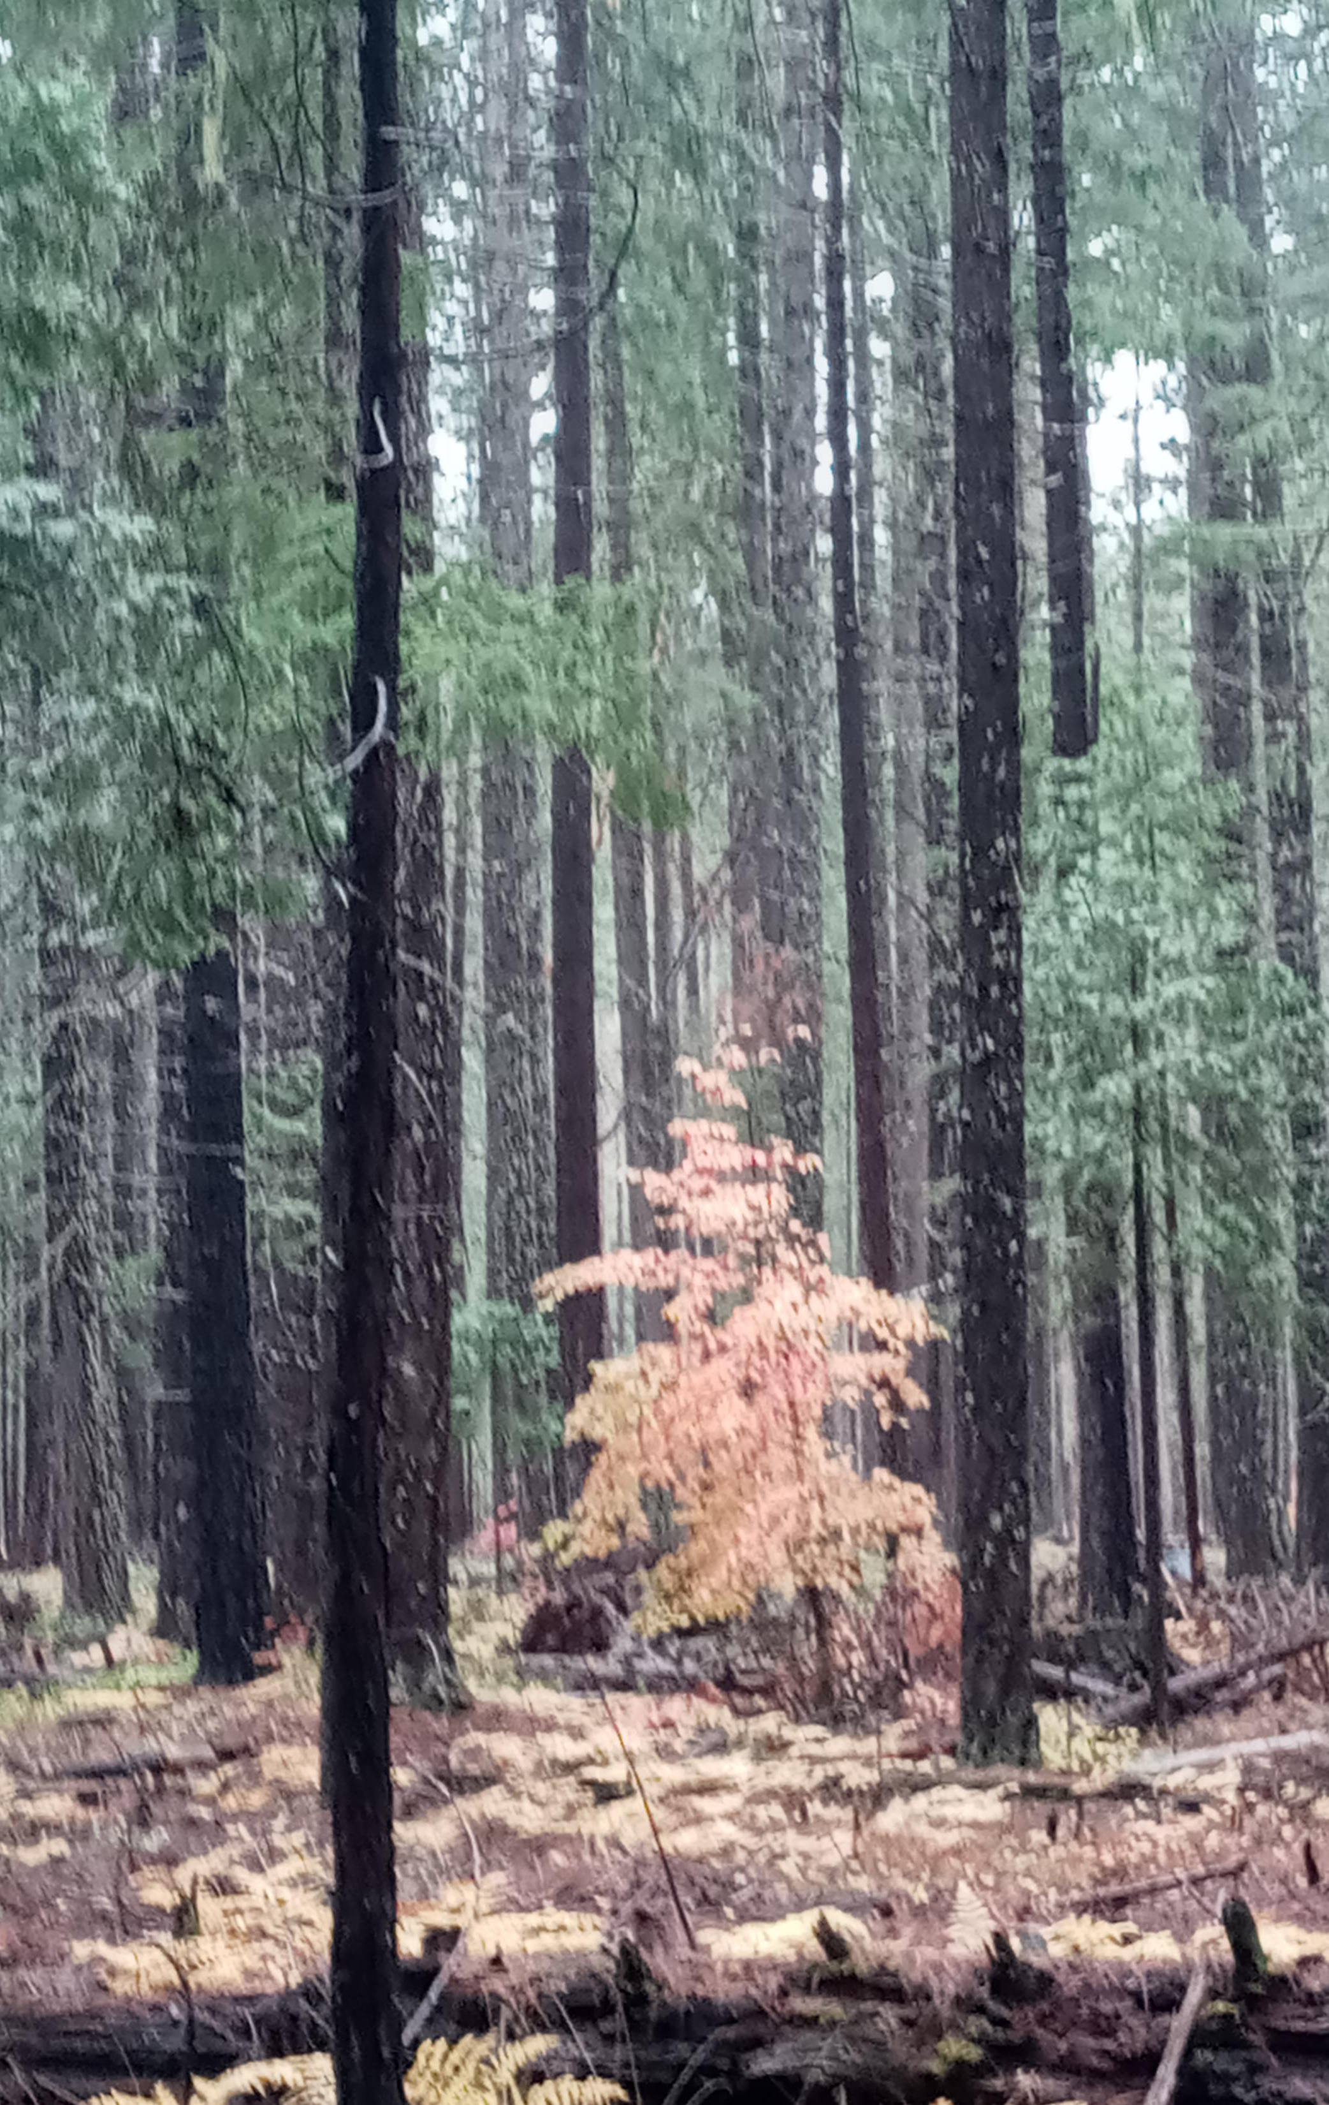
Filtered sunlight and an open canopy allows respiration and air flow while reducing the probability of high intensity wildfires and the retention of annual snow budget. Trametes versicolor or turkey tail mushroom.

Slide 4
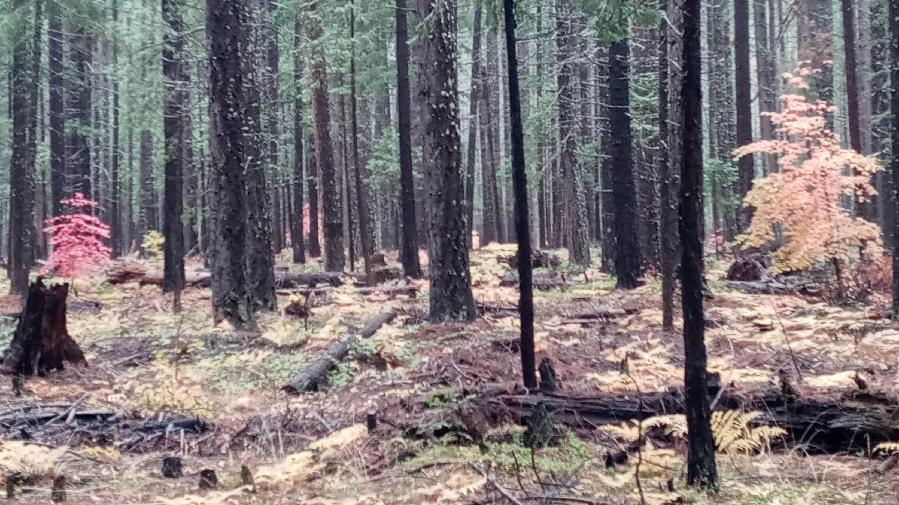
Notice, no scaffolding to canopy that facilitates crown fires.

Slide 5
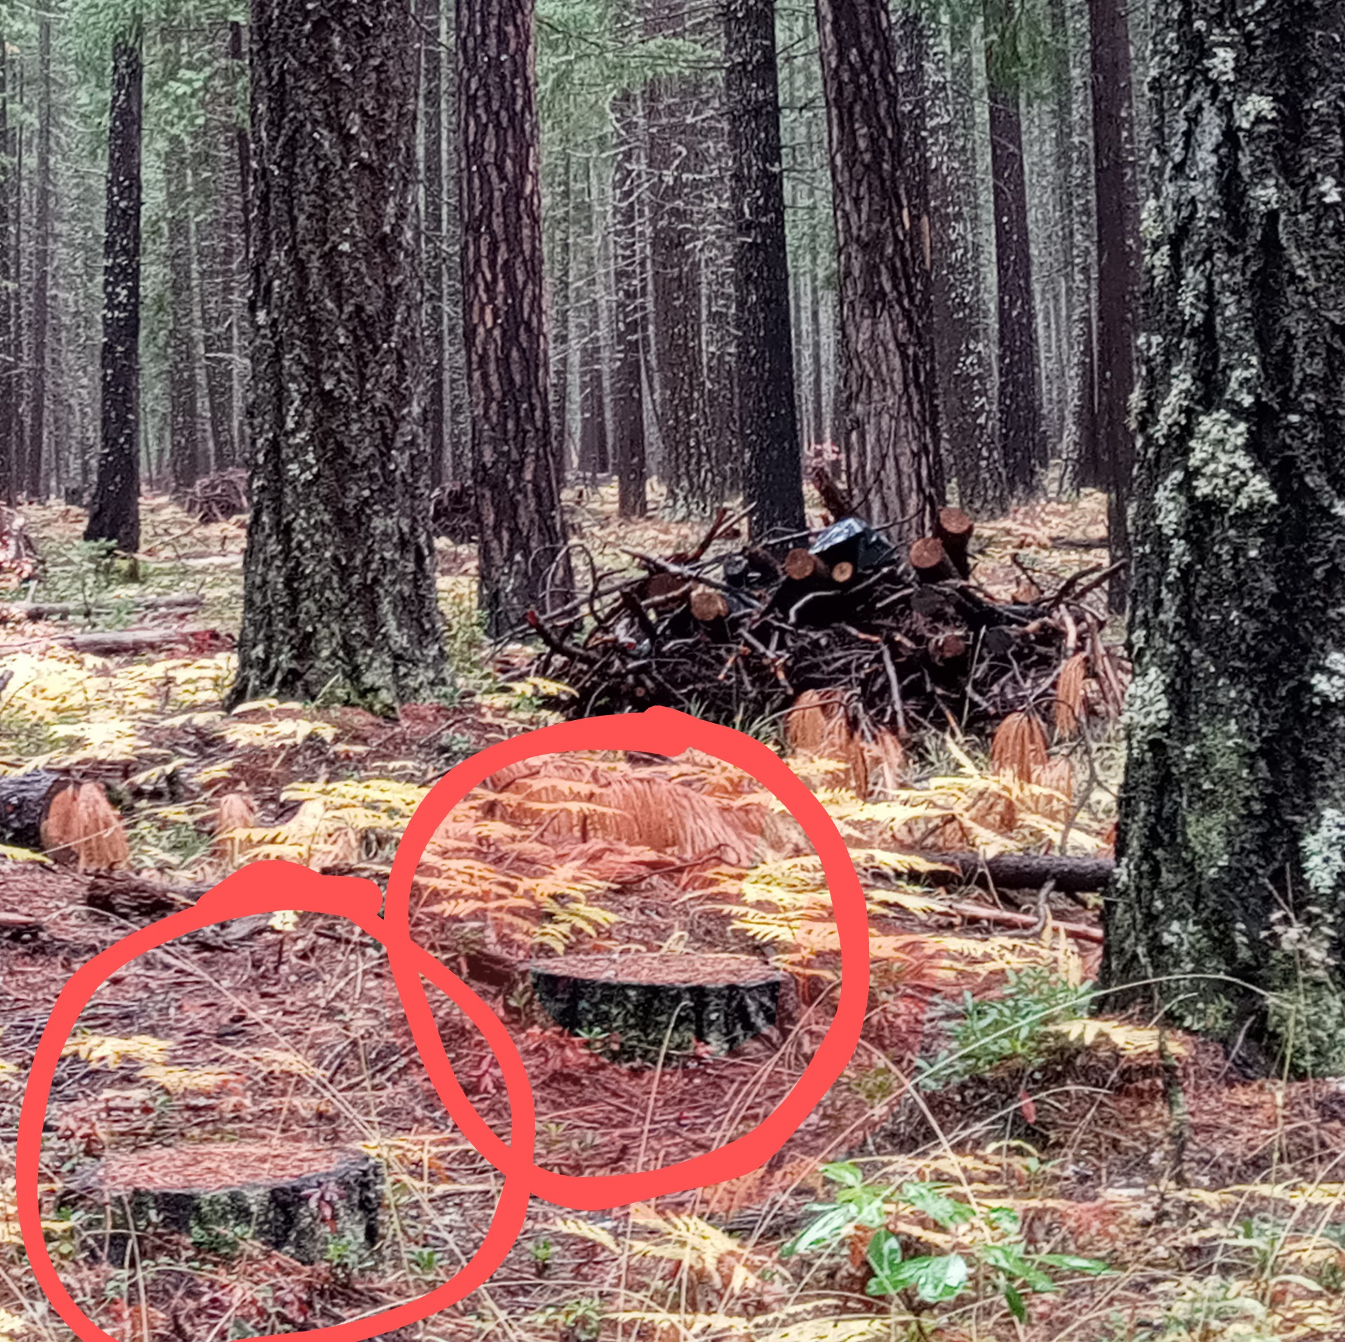
Science-based thinning prescribed fire, and timber harvesting is essential to restoration of resiliency and reintroduction of filtered sunlight opening the canopy to restore respiration to the forest floor and terrestrial story. Thinning would reverse diminishing soil dehydration and disruption of the hydrological cycle while retaining annual snow budget for forest health.
Treatment to reduce crowding and scaffolding to the canopy will also mitigate high intensity destructive wildfire, including crown fires, which were once rare thirteen years ago.

Slide 6
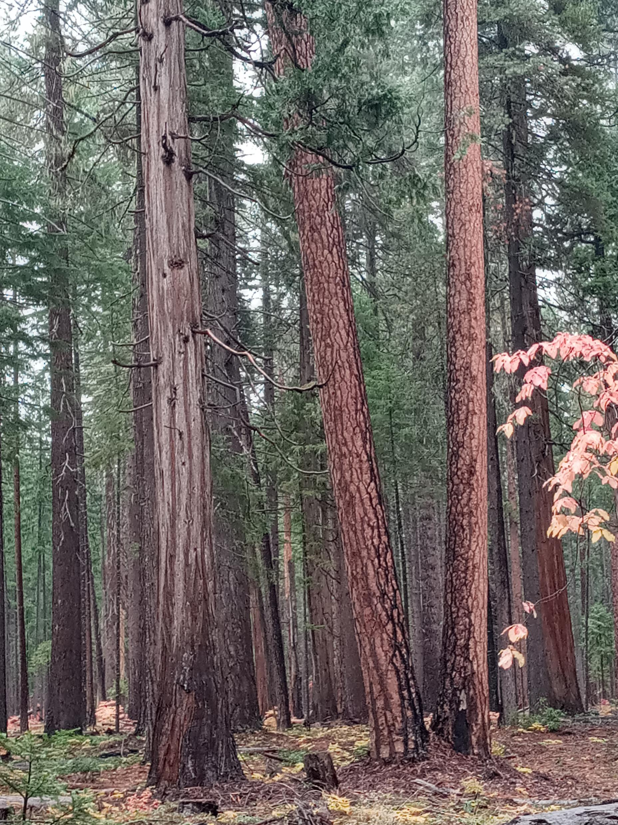
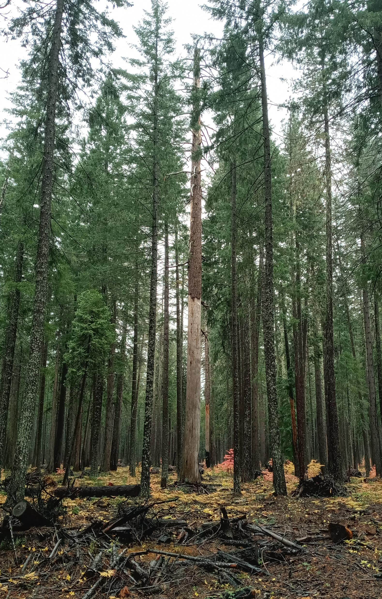
A thinned forest reflecting an open canopy with filtered sunlight to the forest floor for restoration of respiration and resiliency.
A treated forest is a beautiful sight. The forest thanks you for letting it breathe again. FUS

Slide 7
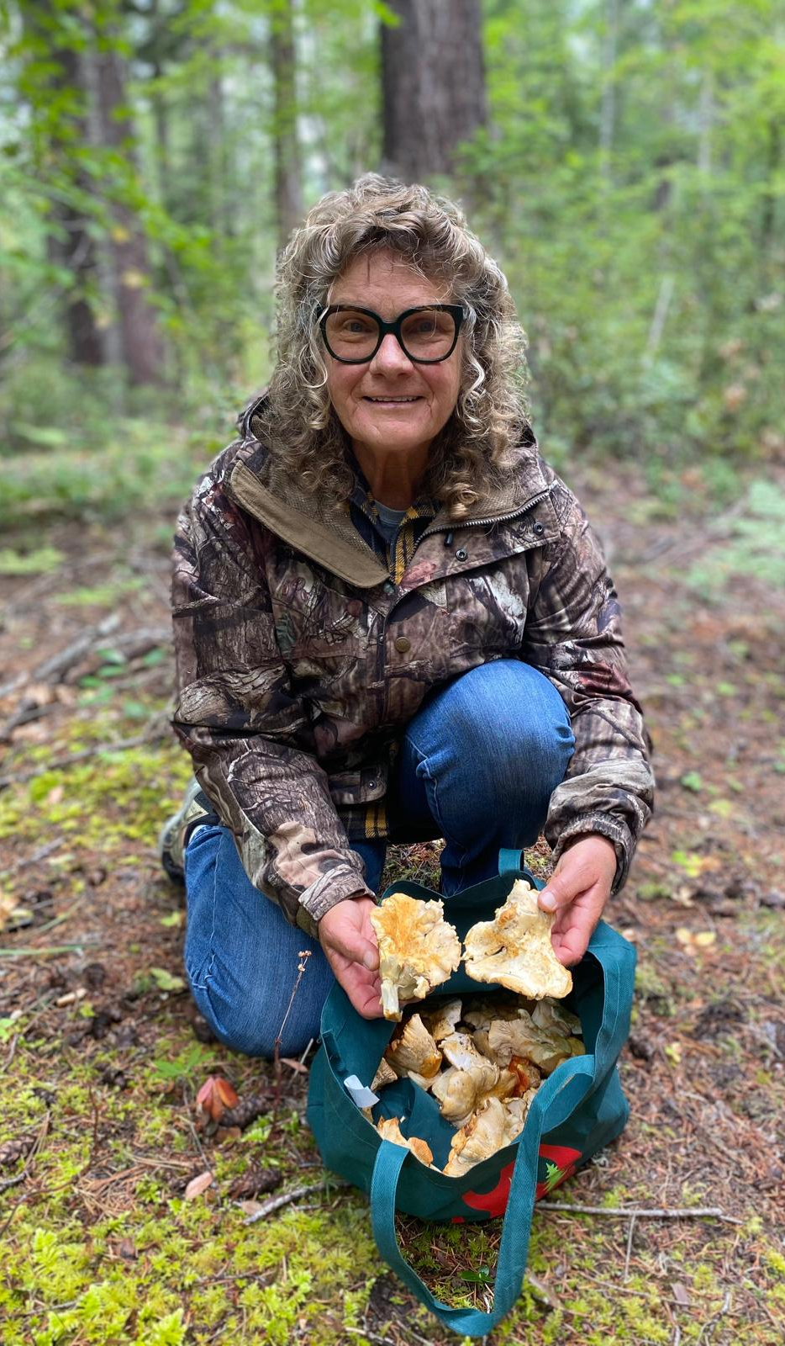
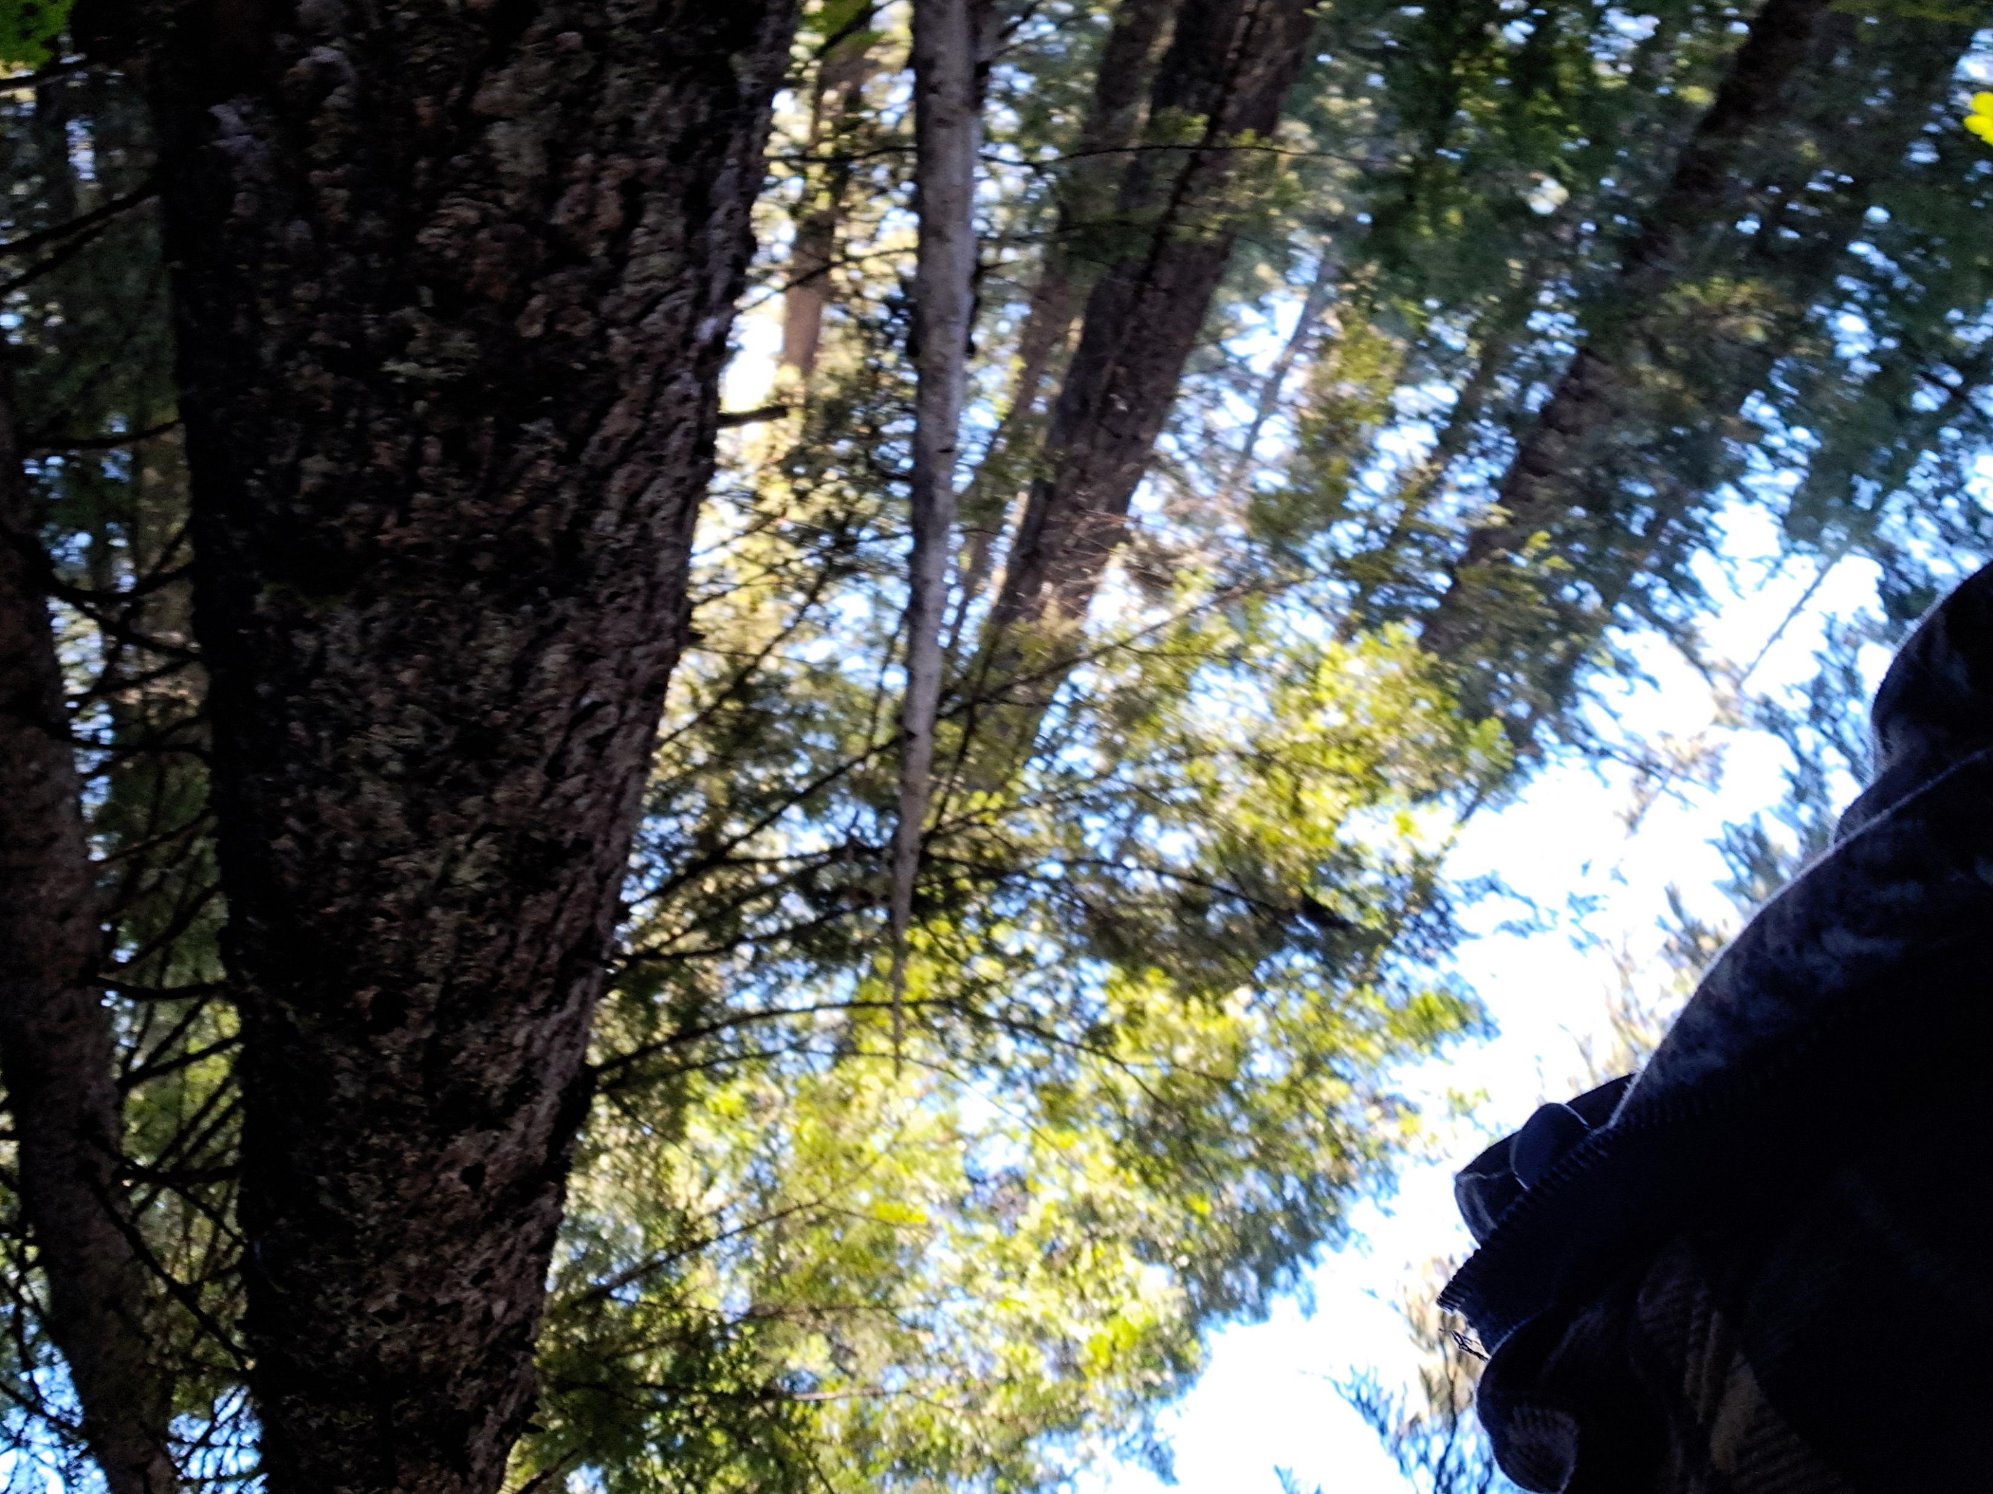

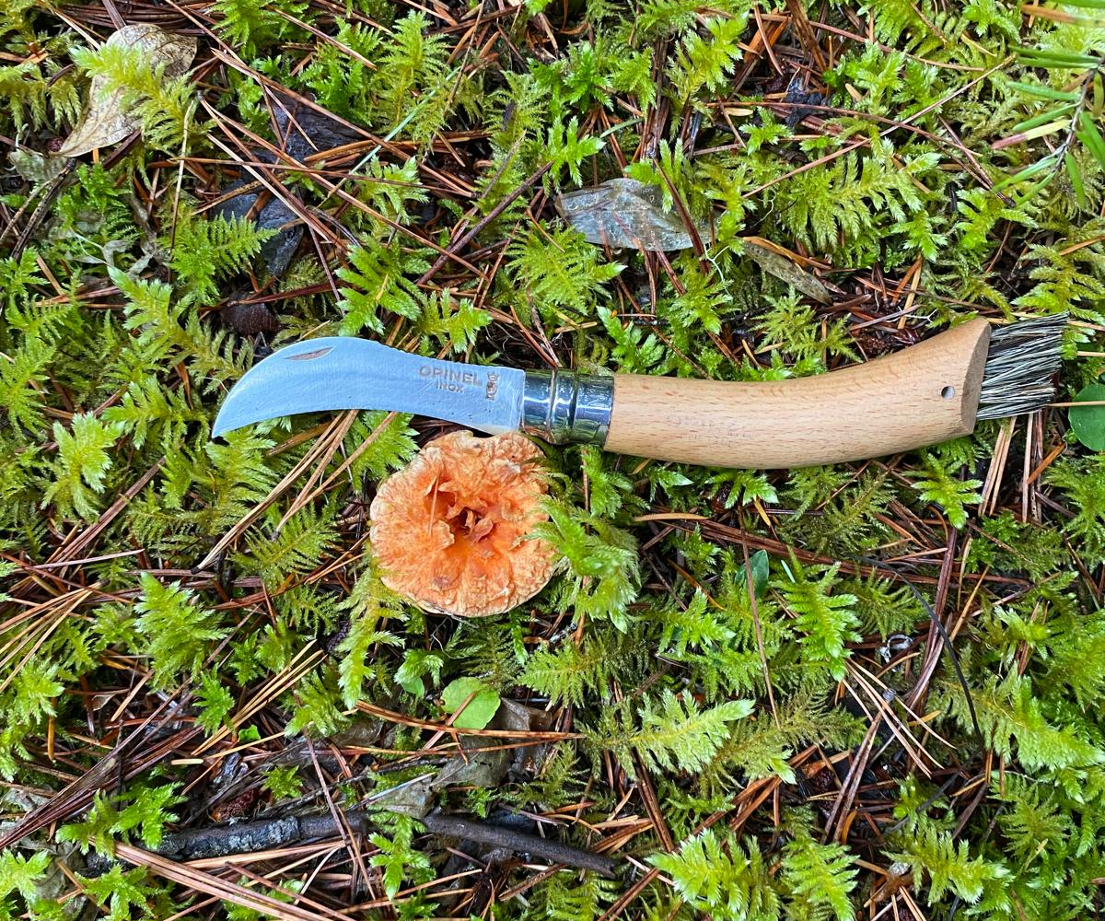
Filtered sunlight to the forest floor is a resilient forest

Slide 8
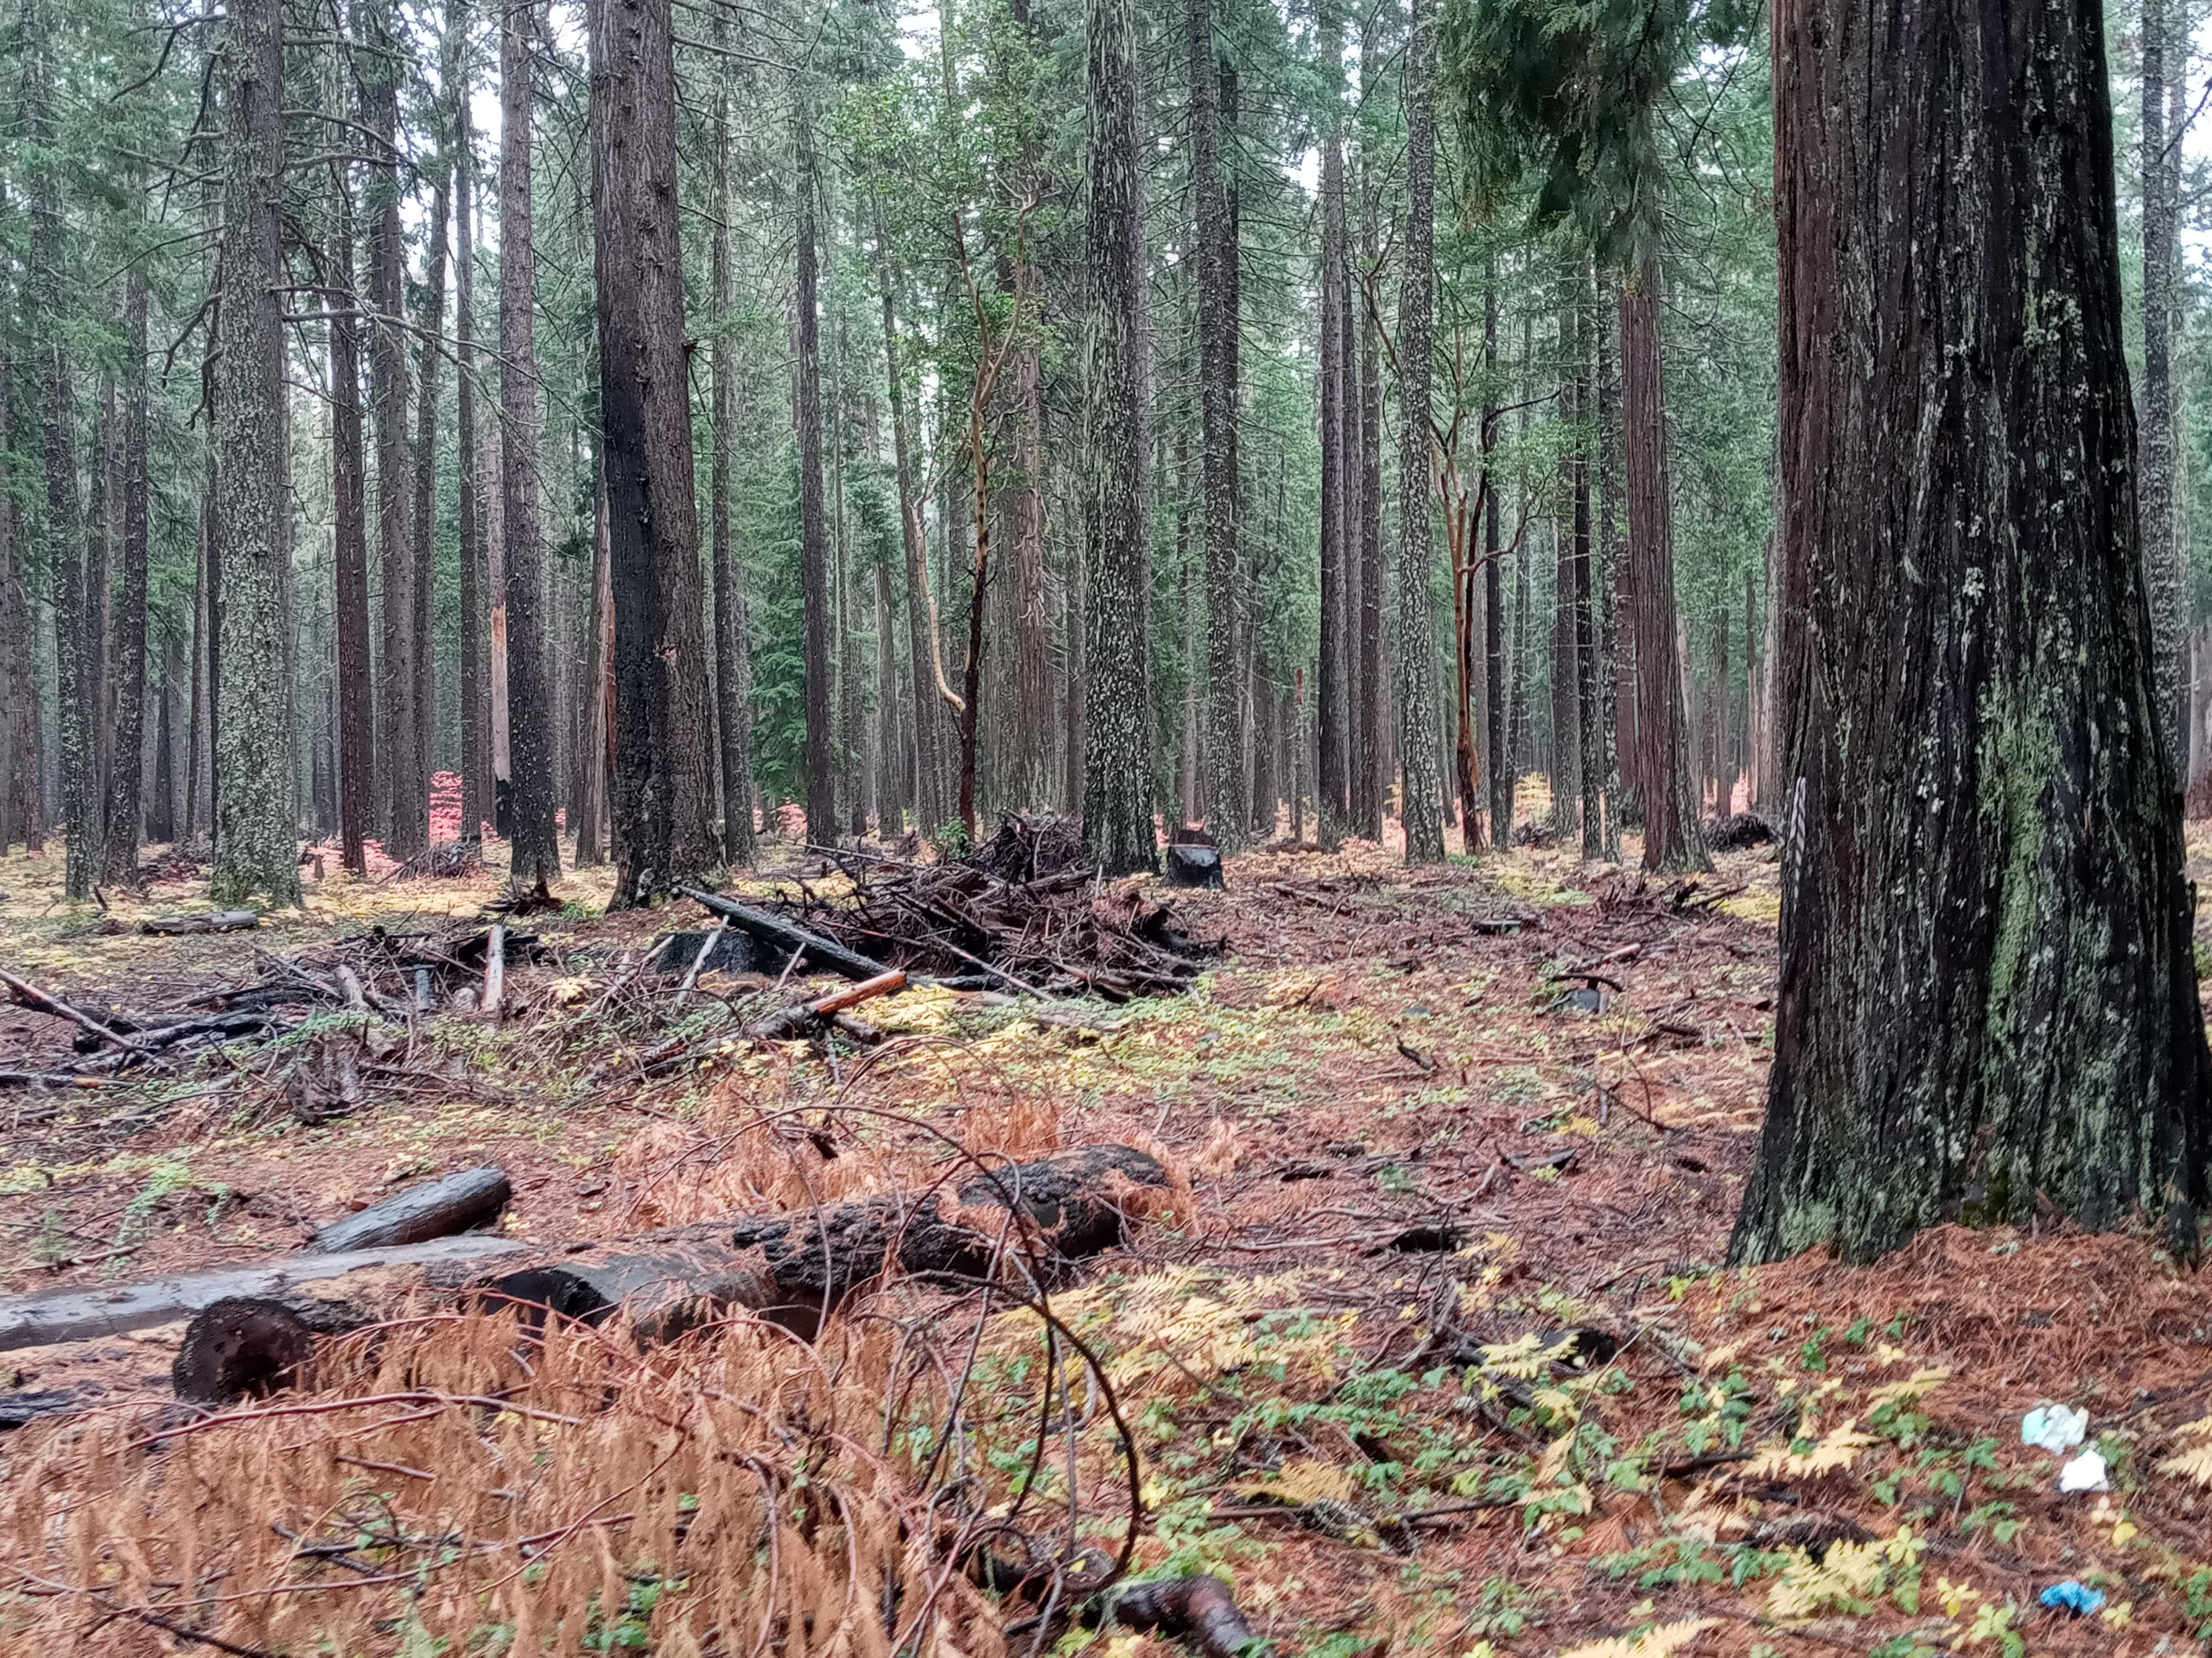
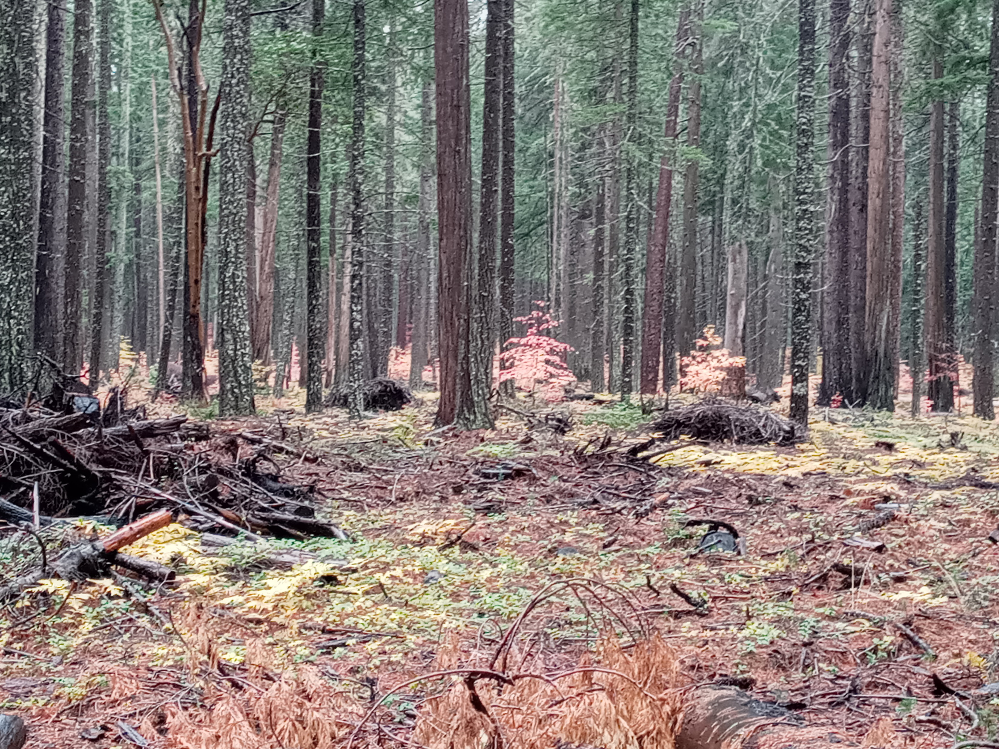
A FUS memory —
Seven summers past, while on a forest field trip in the Fremont-Winema NF with a tribal leader from the Confederated Klamath Tribe, memories were shared by him of hunting elk with his father and how they could drive his dad’s jeep through the forest off- road, as through the dry forest, similar to these photos. Today, in one generation, the untreated forest became a tangled mess, unimaginable in his father's lifetime. Below is a treated resilient forest.

Slide 9
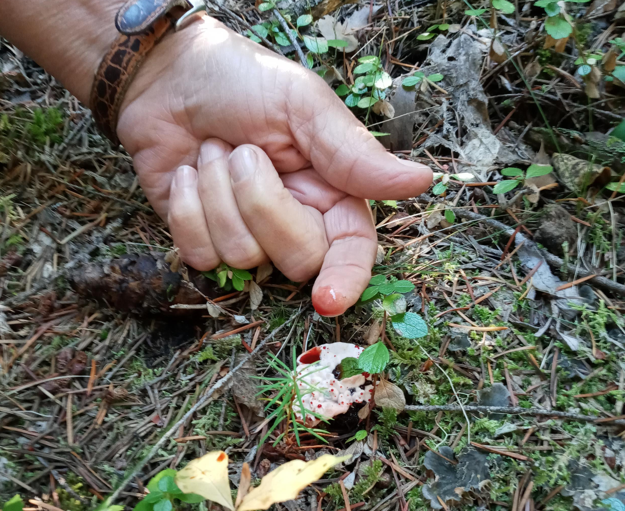
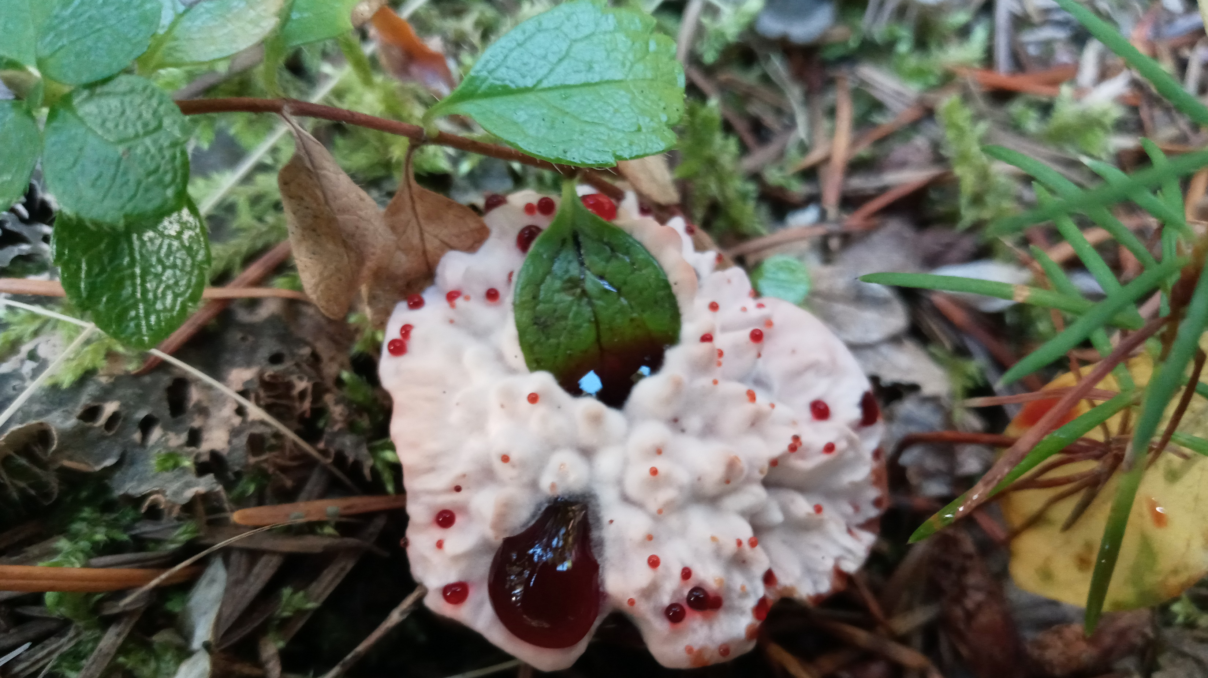
It’s fall in the RR-SNF. Is this a wounded deer dripping blood or a Devils Tooth mushroom?
Devils Tooth Fungus: Hydnellun peckii thrives under conifers. This mushroom has a symbiotic relationship with the conifer trees and in the autumn transpiration (moving of water) occurs when the soil profiles are saturated. Root pressure forces water through fungi glands extruding red that resembles blood. This occurs when the forest floor is thoroughly saturated with moisture indicating forest health. Its absence to FUS, in some fall seasons, indicates probable dehydration in soil profiles for proper fall dormancy of the forest landscape. Photo taken fall 2023.

Slide 10
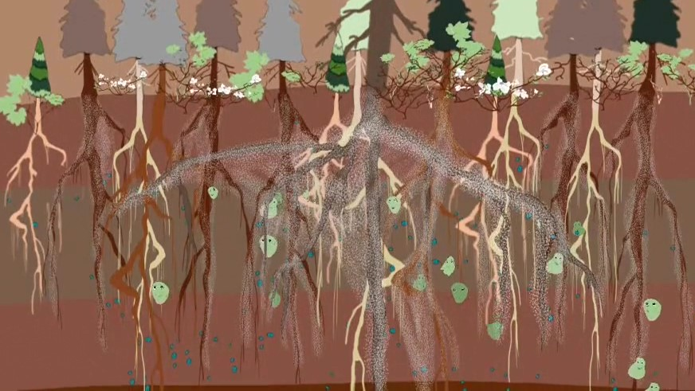
Mycorrhizal colonies symbiotic relationship with the host tree broker an exchange of minerals and nutrients through moisture, especially critical during stress and drought.
Too many trees competing for limited moisture during drought rapidly accelerates stress

Slide 11
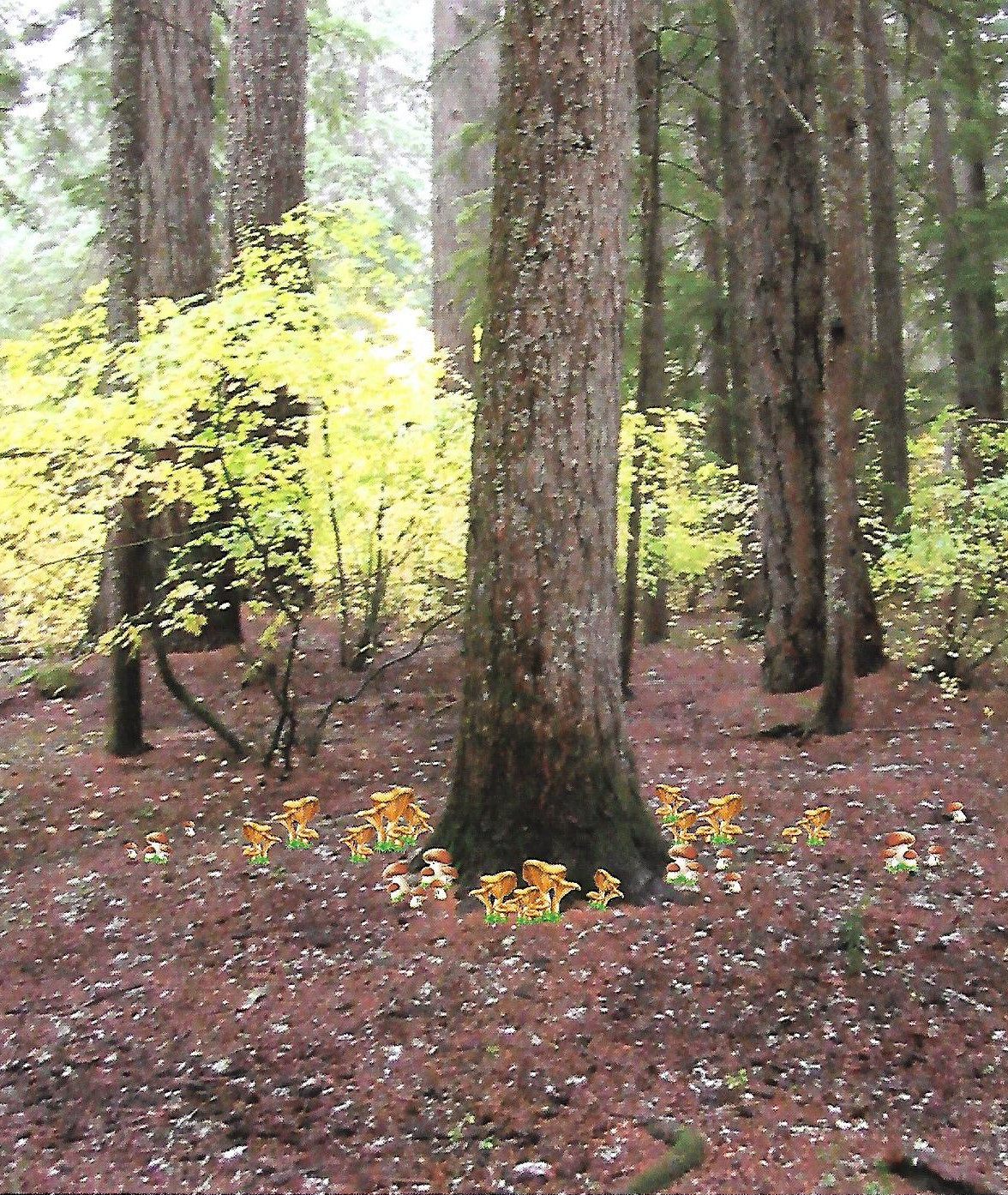
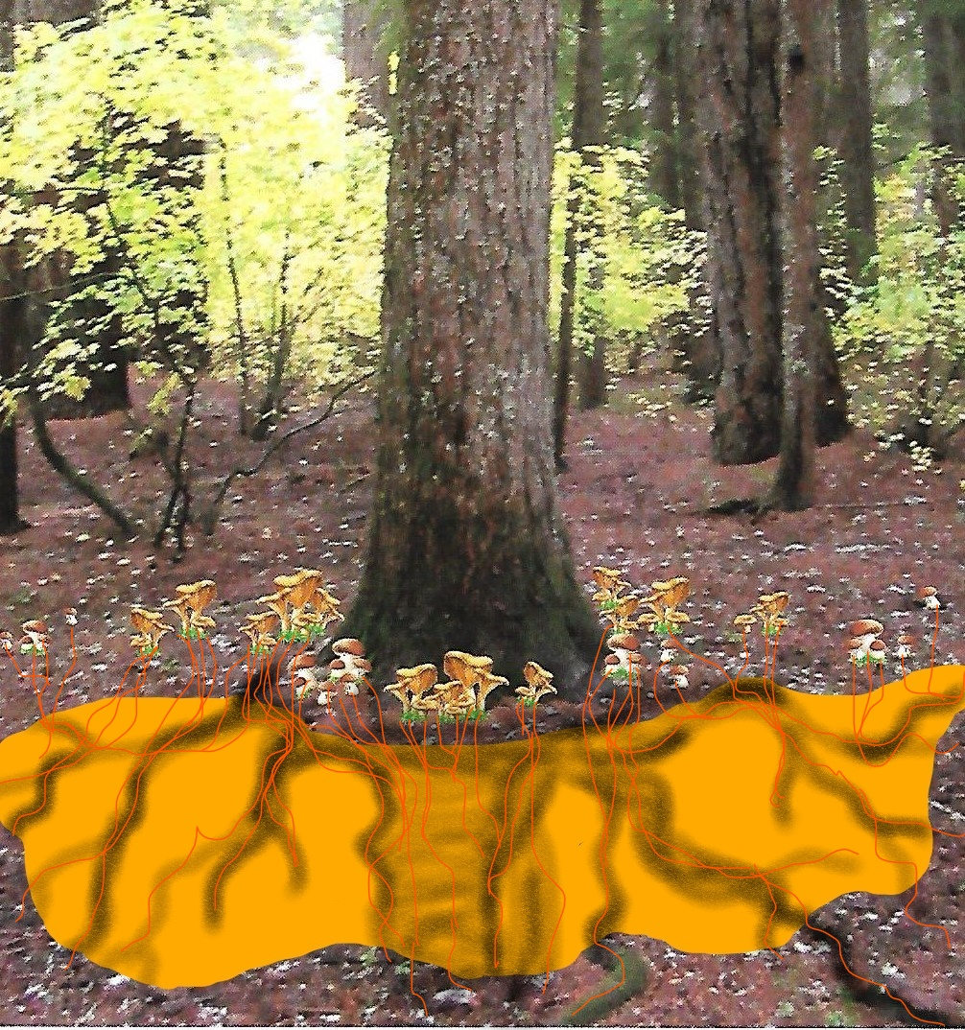
A symbiotic relationship in a healthy forest with fall emergence of Chantarelles. The fruit of the fungi from the mycorrhizal colony below ground has a mutual relationship for known, and yet unknown reasons, in the host tree's root system.
Cantharellus or Chanterelles

Slide 12
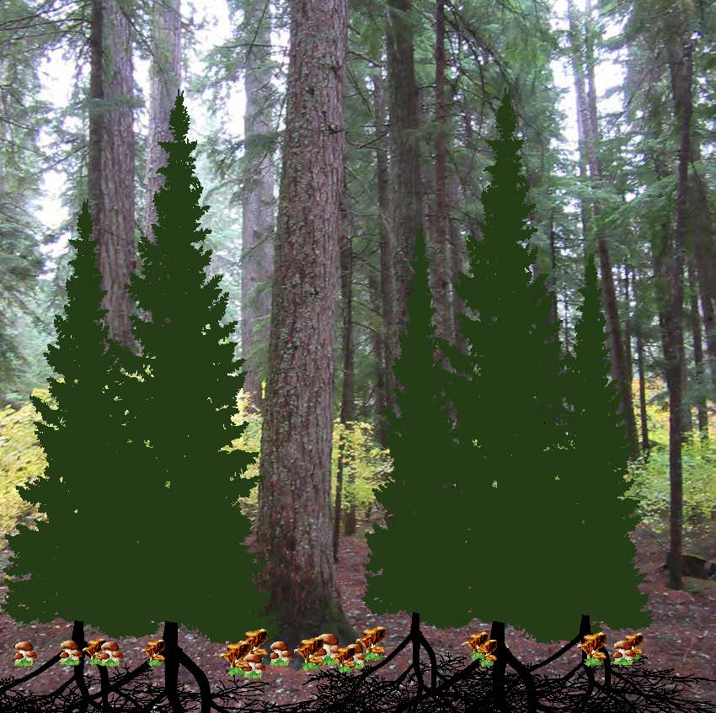
  Crowding of the forest floor significantly hinders filtered sun light. In less than a few decades, if not thinned and prescribe fire reintroduced after thinning the disturbance in the natural wildfire cycle results in competition for sunlight and moisture. This set the forest stage for annual loss of resiliency and a crowded forest floor condition competing for limited moisture and sunlight. This condition was manmade by lack of Active Forest Management.

Slide 13
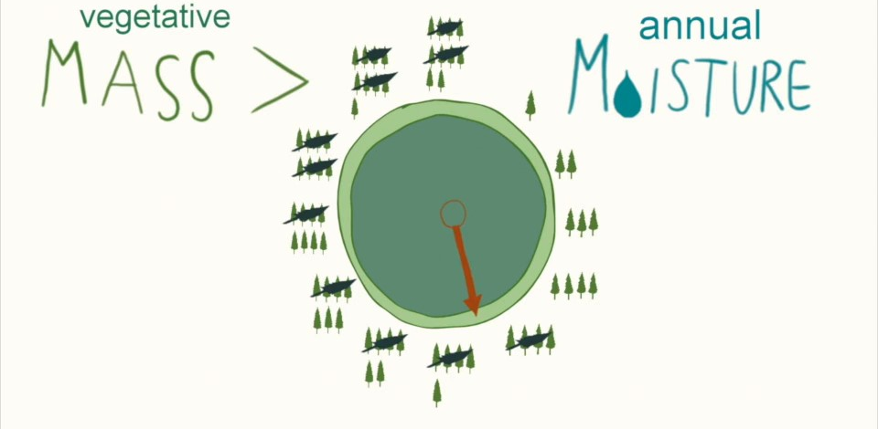
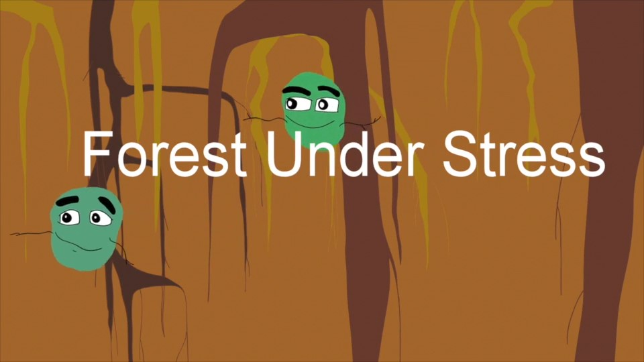
Lack of Active Forest Management over the last thirty years not only continued to disturbed the natural wildfire cycle but broke the hydrological cycle. It is cumulative in nature. Moisture is the conduit of exchange for life sustaining carbohydrates, nutrients and minerals; however, when competitive vegetative mass exceeds annual moisture's ability to sustain the terrestrial story in the forest, the forest became prone to insect infestation, disease and wildfire as it loses resiliency in diminishing returns, therefore it is cumulative in nature. Too many trees.
Forest Under Stress the Movie is an international award-winning short documentary by Forest Under Stress. View below.
https://healthyforests.org/2022/03/short-film-forest-under-stress/

Slide 14
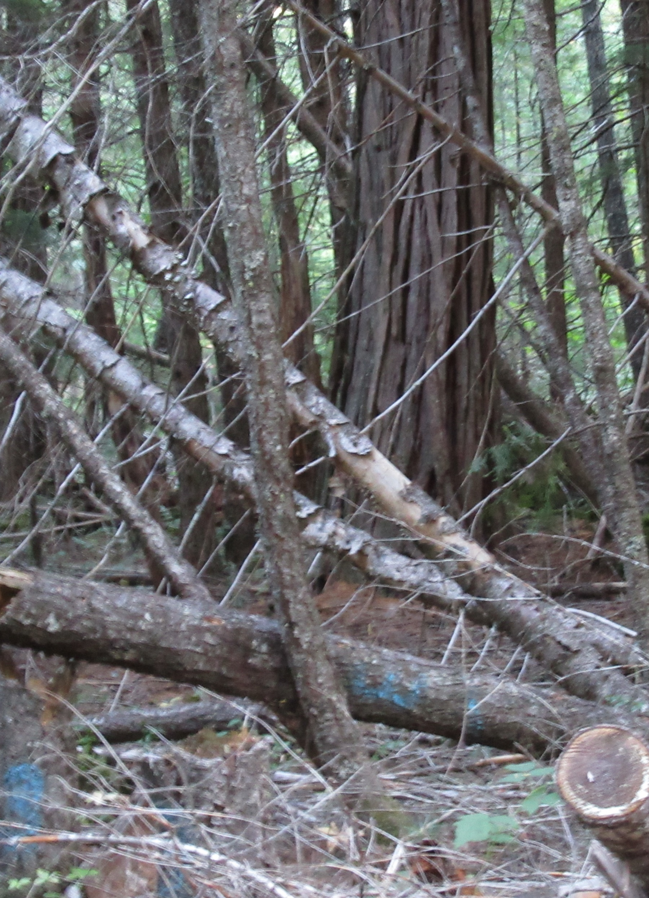
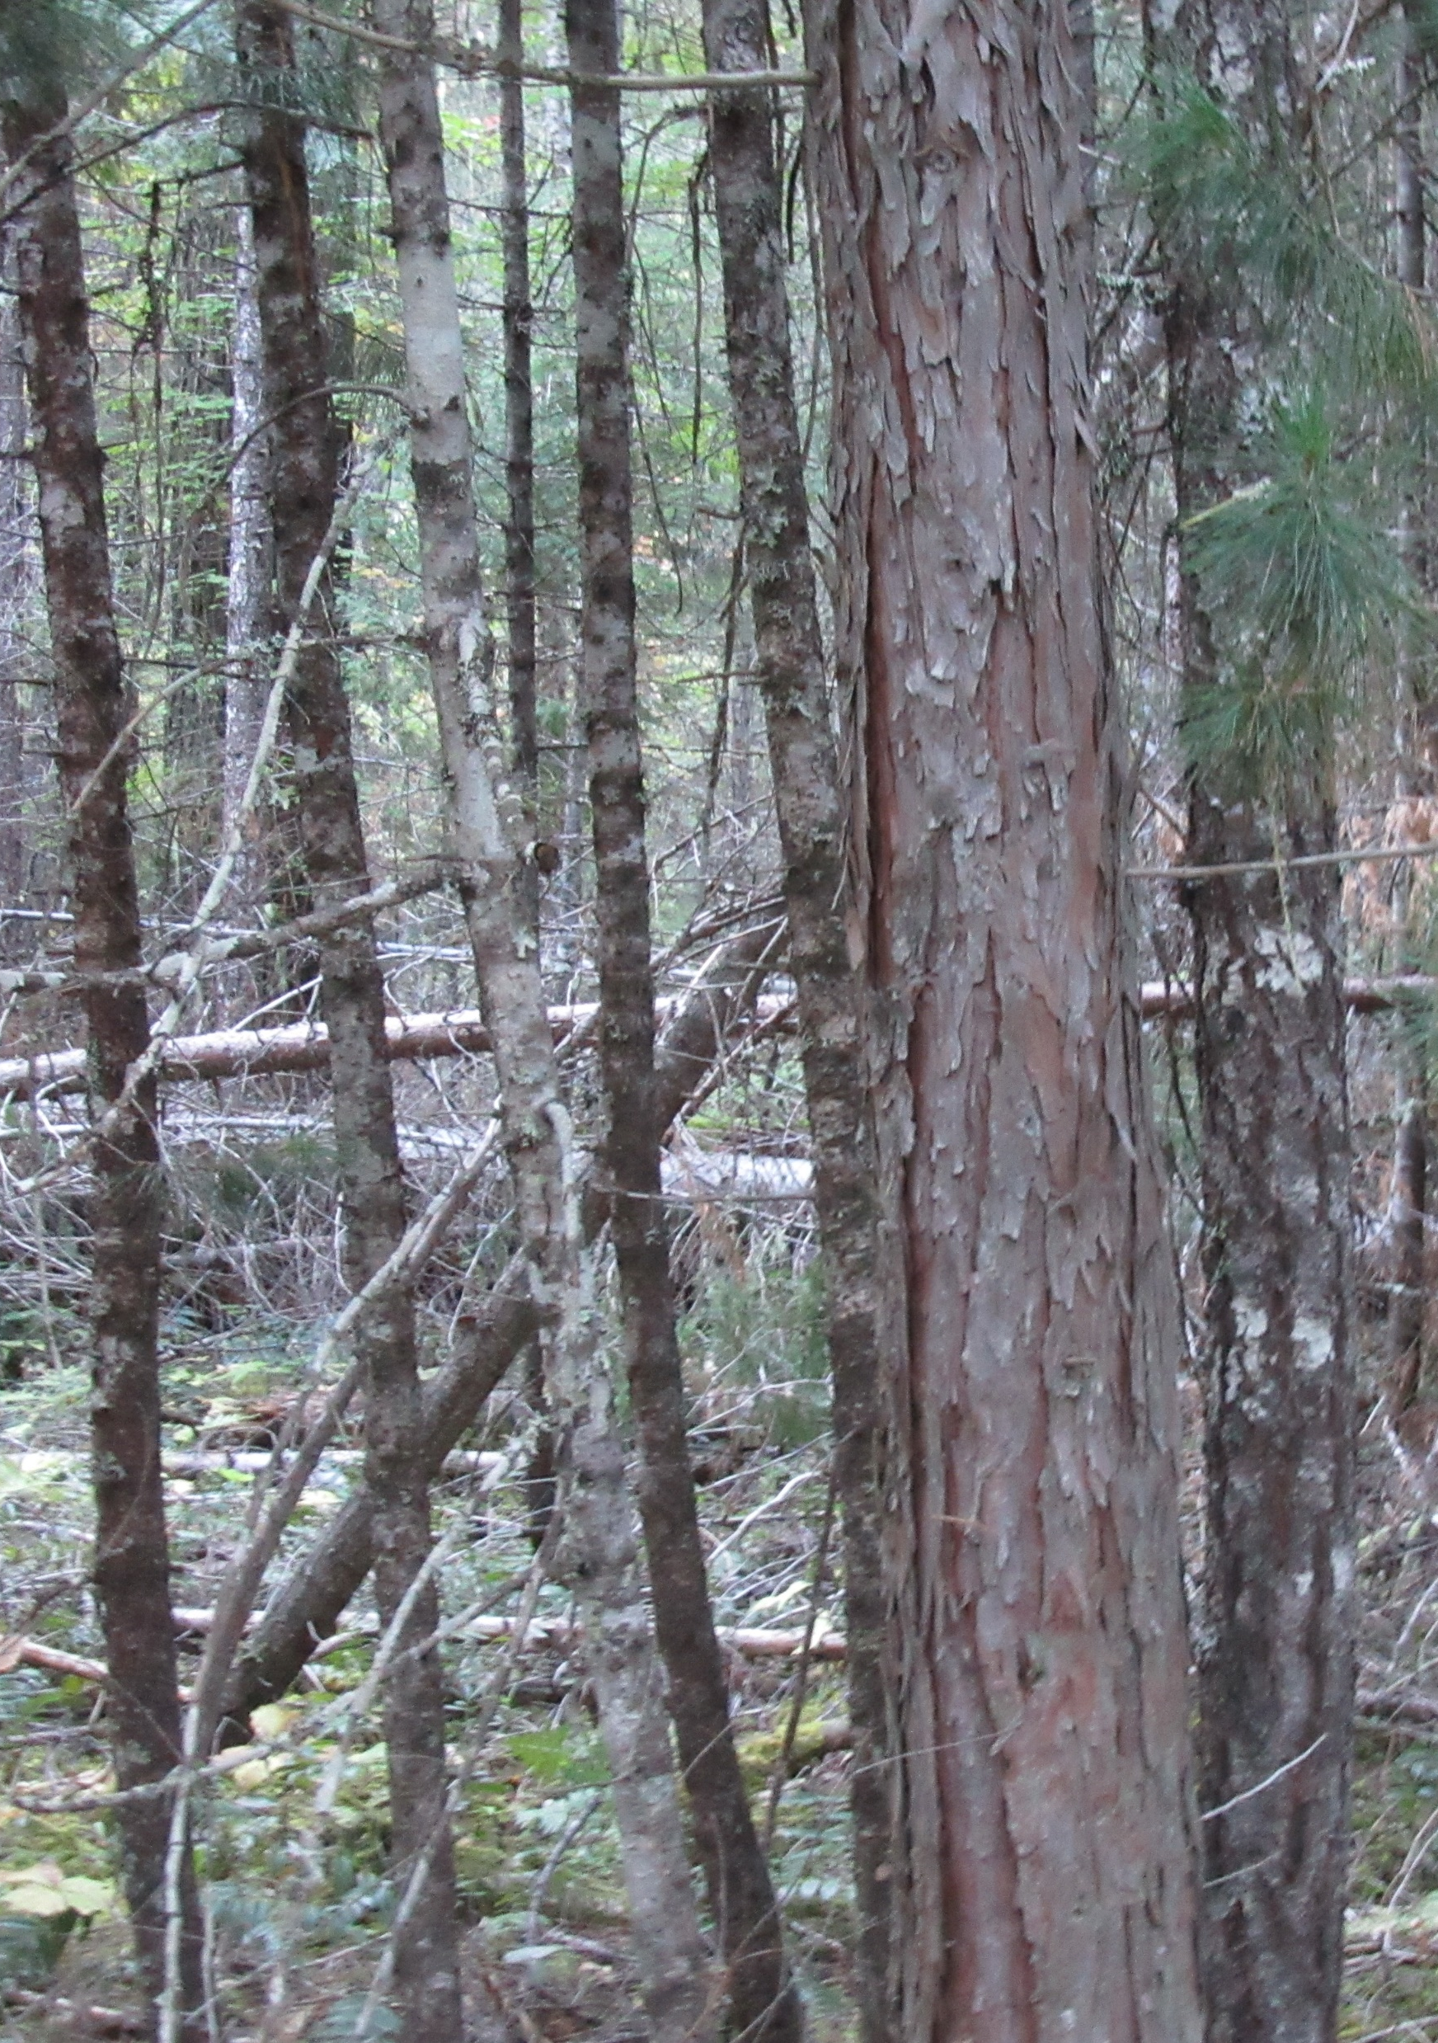
Thinning the clogged forest restores natural avian flight and mammal movement, eliminating unnatural magnified hindrances in the terrestrial story. A cluttered forest floor allows detection of movement for predators, which is also detrimential for non-predatory animal's survival.
The cluttered forest floor produces sound upon movement, alerting predators and pray alike. This cluttered forest significantly hinders natural movement in the terrestrial story, a losing scenario for wildlife.

Slide 15
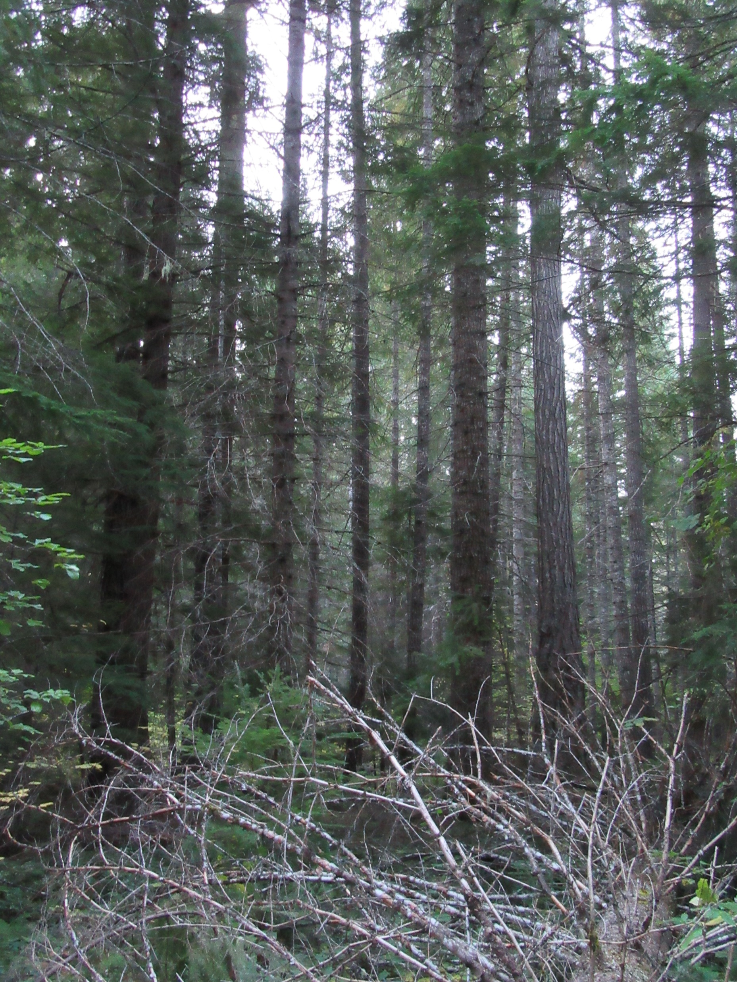
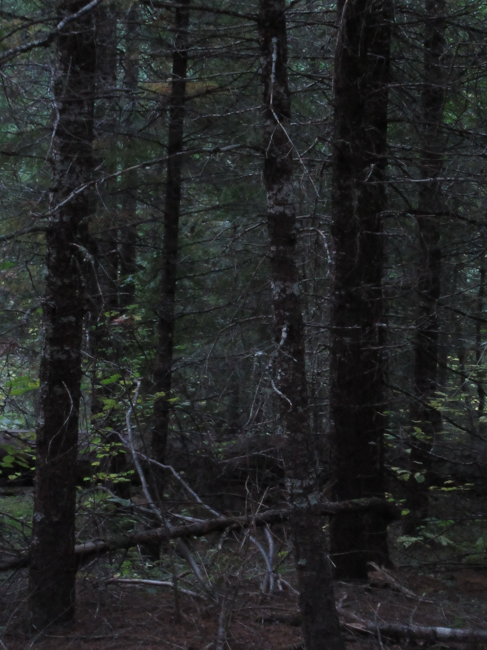
The
Loss of respiration and filtered sunlight created a closed canopy, a reduction of airflow and dehydration of upper soil profiles siphoning-off critical moisture ( annual seasonal snow retention is inadequate) for the excessive competitive vegetative demands, which increased stress.
The forest darkened as canopies closed from the massive buildup of vegetation.
This stress occurred from lack of Active Forest Management

Slide 16
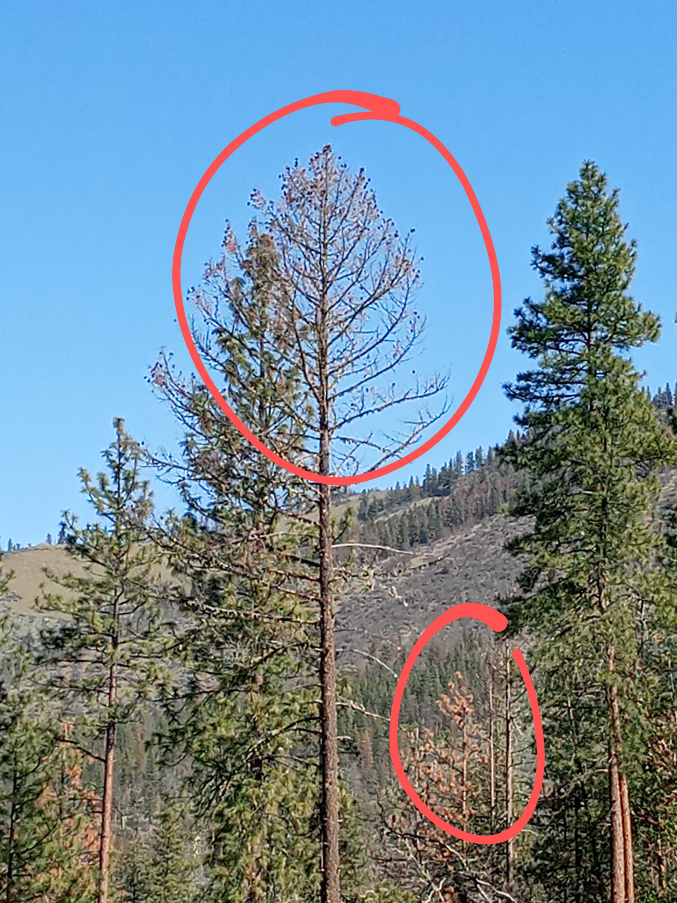
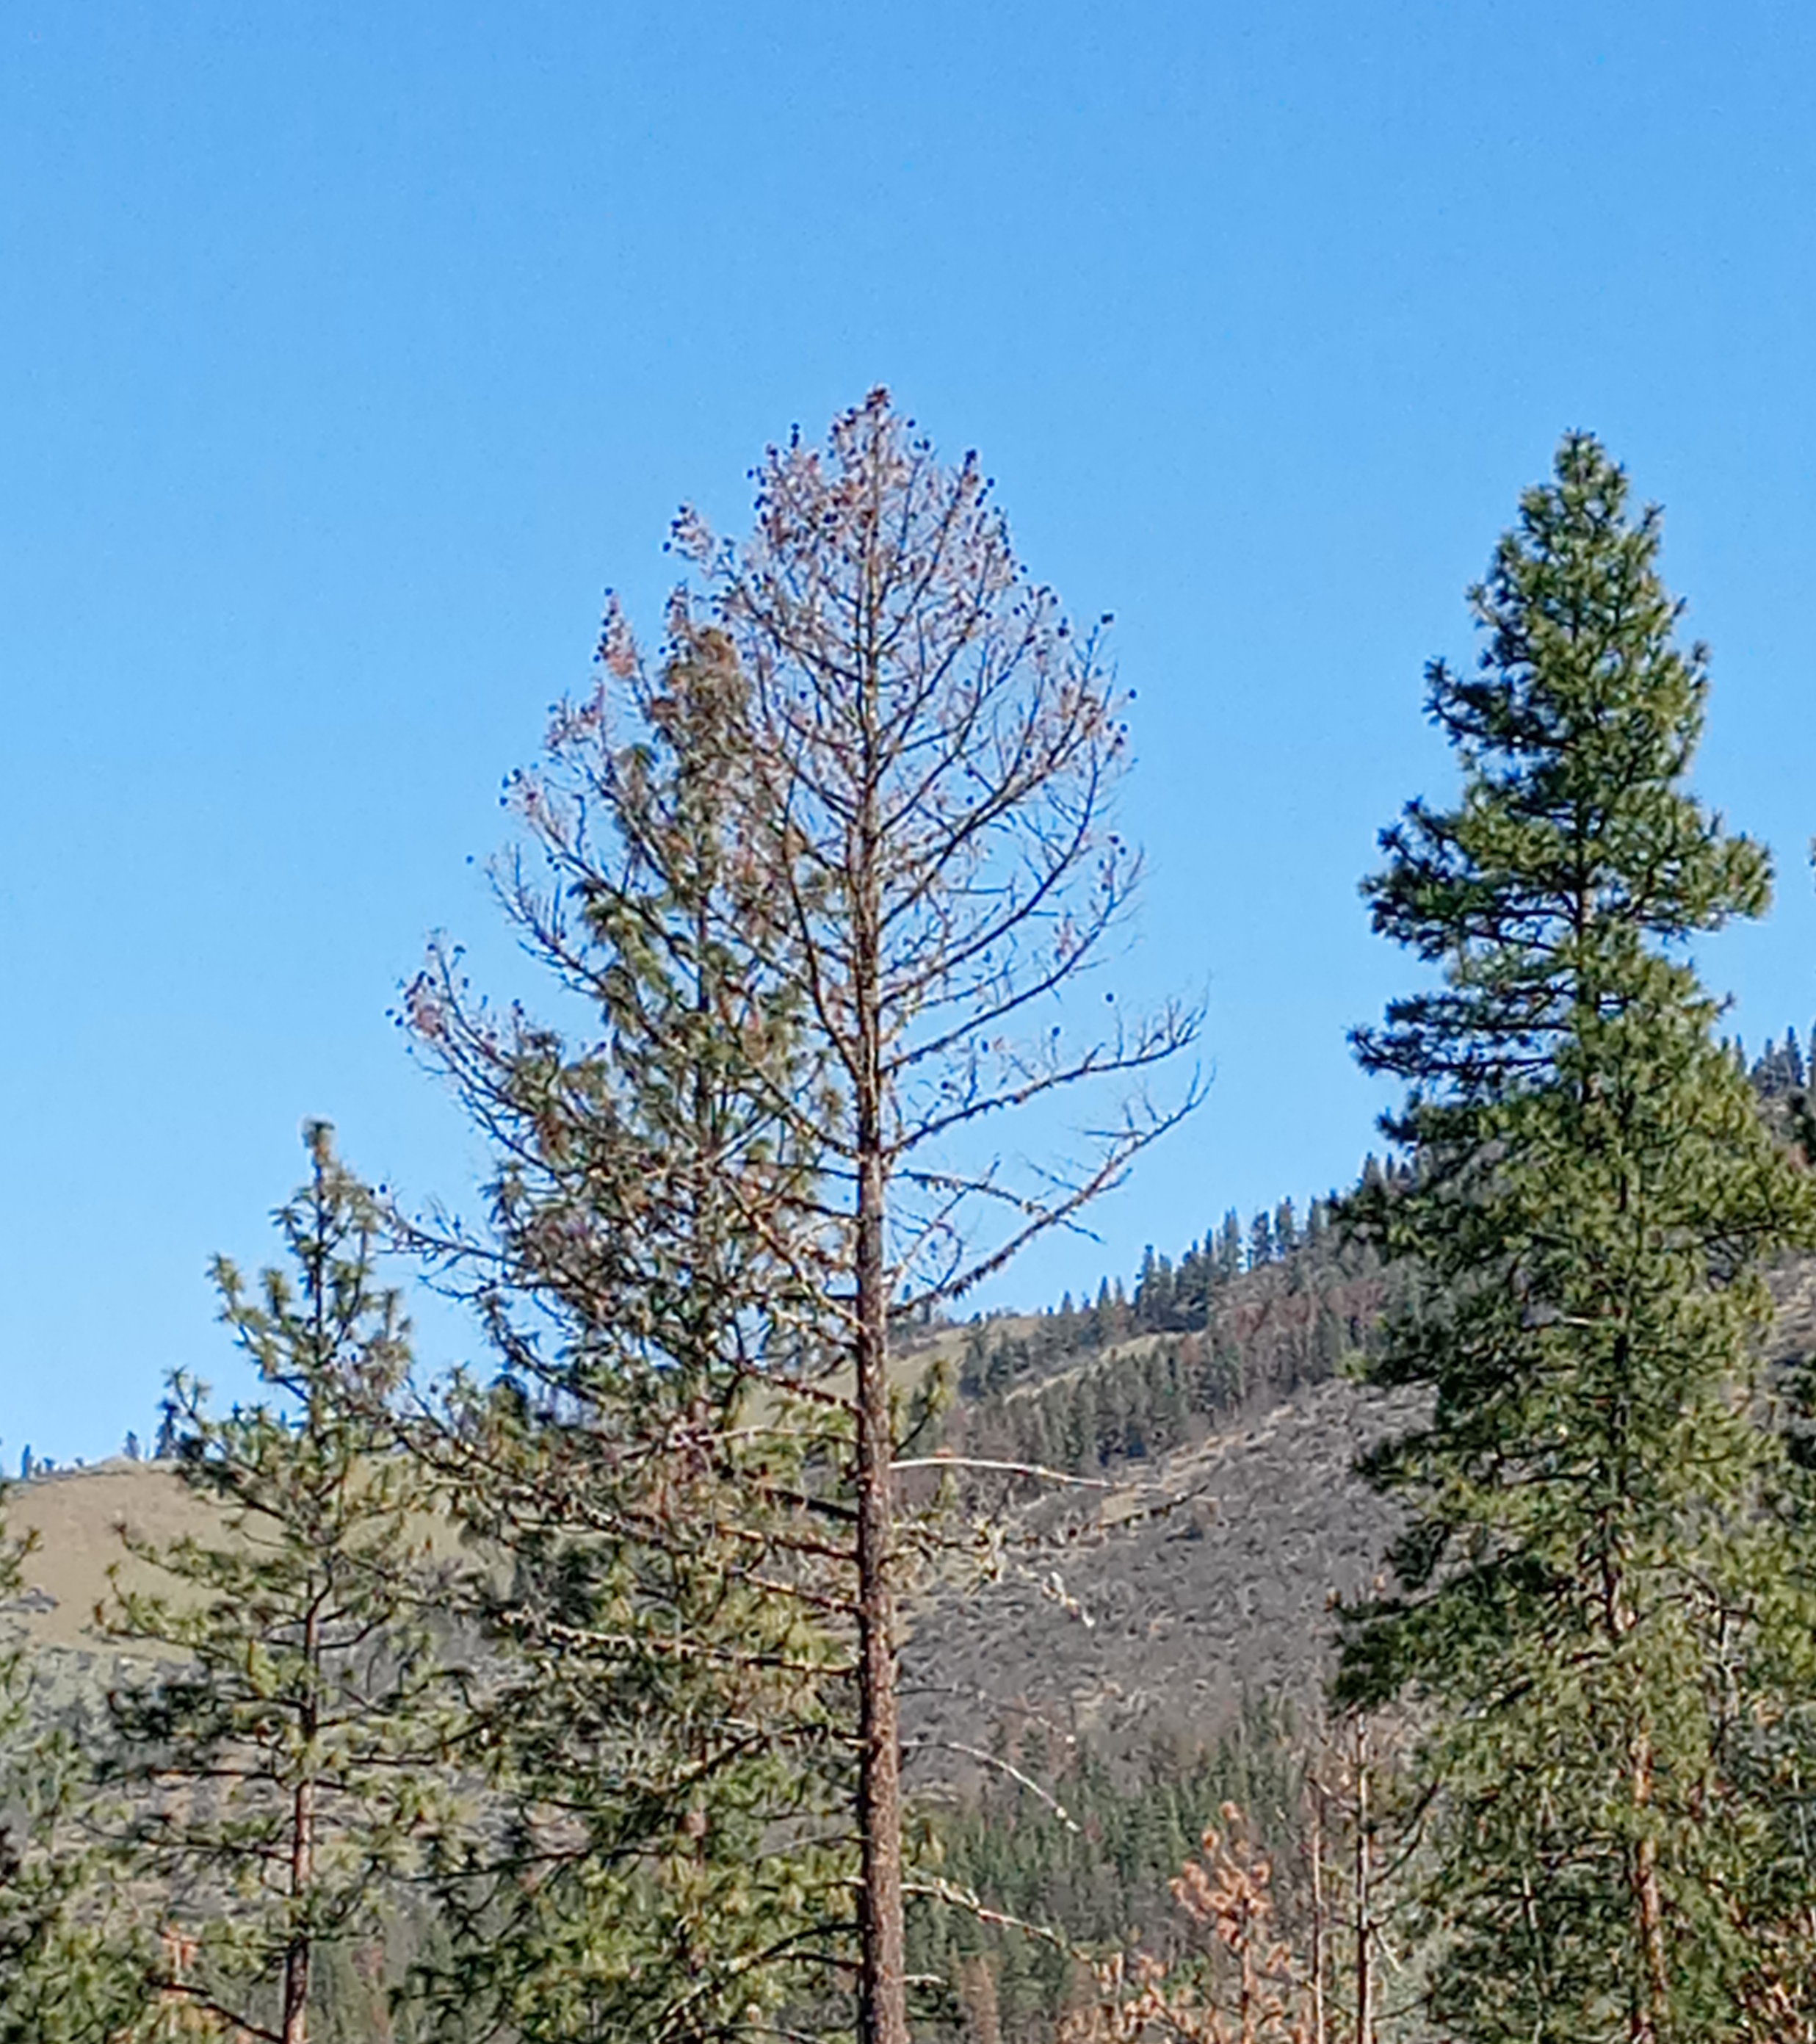
Sudden Death of Douglas-fir in Southern Oregon 2024
In the case of sudden die-off of the Douglas-fir, the elder trees discerns the season it is going to expire and uses all its reserve energy in green biomass “carbohydrate storage” to direct energy to cone on its crown to save its DNA Legacy the last season of its life. What it does not know, is there could be crown fires, once rare that will destroy this noble effort to save it DNA Legacy. Once infestation of the Flatheaded Fir Borer infests its weakened host, the sudden death can present in a few weeks as witnessed by FUS in Southern Oregon.
The prolonged stress of drought ( view Maga Drought 2020 HFHC) and demands for moisture from over crowding facilitated the flatheaded fir borer and disease to ring the death knoll showcasing the Sudden Death of Douglas-firs in the RR-SNF. Nevertheless, the forest was in decline for decades from lack of Active Forest Management to thin, preserve, and restore respiration to the forest landscapes allowing it to become vulnerable to the borer.

Slide 17
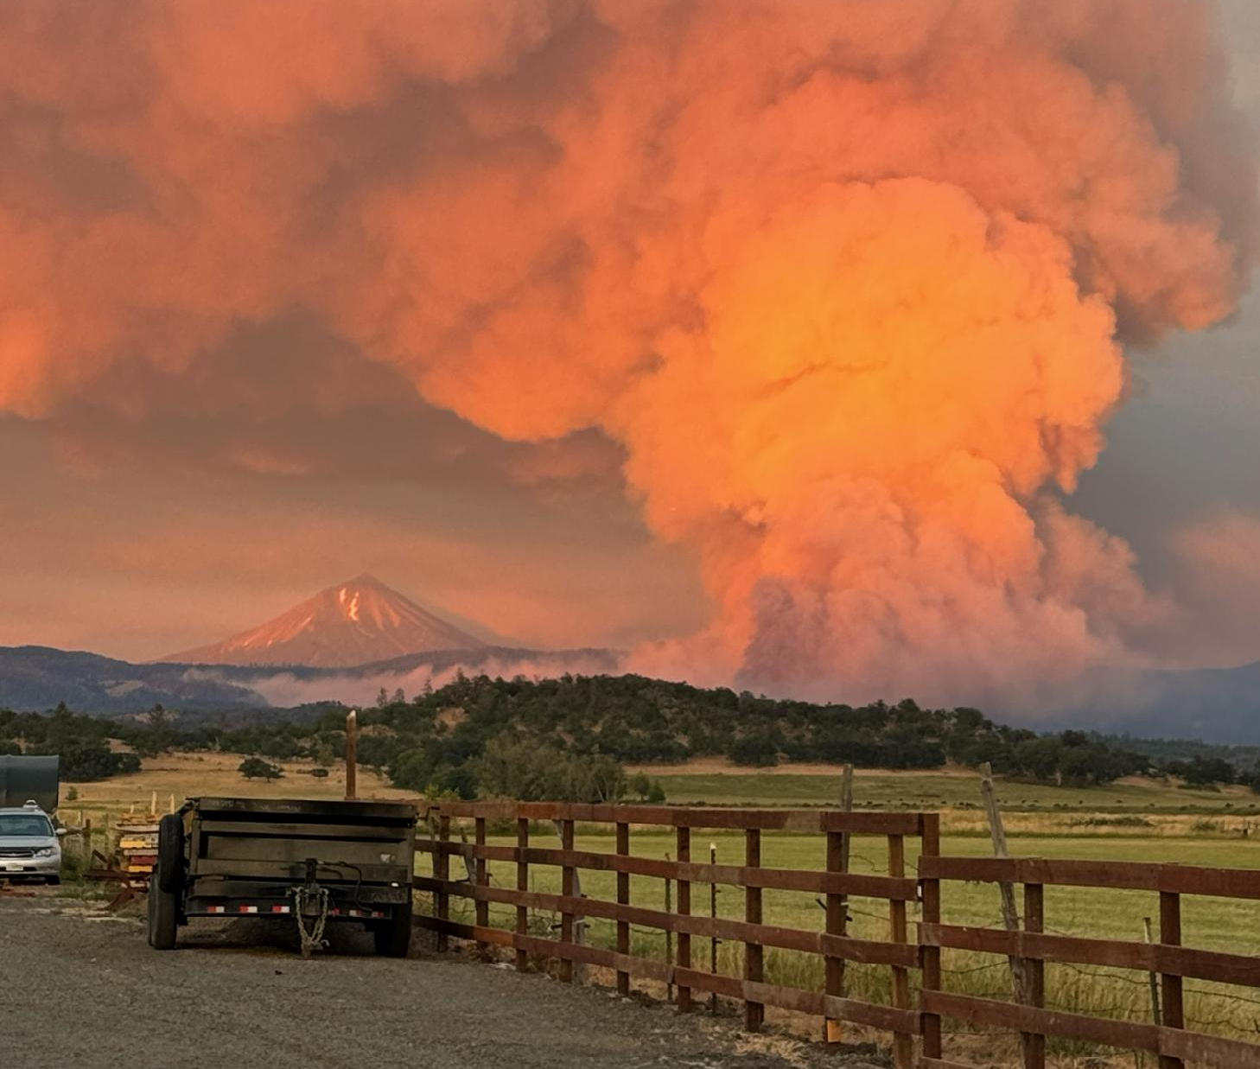
Eagle Point, Oregon Salt Creek Wildfire July 2024
Photo: Angie Andrews backyard
Wildfires do not need to just happen. Only you can prevent crown fires once rare- FUS.
First, Put out the FIRE!
Jim Peterson-Evergreen
Notes:
Observations of treatment today in Rogue River N.F.
A photo review of a recently treated mixed conifers-deciduous forest and active prescribed burning.
The restoration of filtered sunlight resulted in respiration goals achieved, scaffolding removal to reduce crown fires, competitive vegetation and volatile fuel load reduction, including strategic removal of valuable timber to off- set cost of treatment (See red rings around stumps for diameter for size).
This restoration enhanced forest floor navigation for large mammals, including avian flight.
The probability of restoring maximum health to mycorrhizal colonies.
All this is due to less demands on the forest ecosystem, which reduces stress for the forest biota.
A beautiful sight.
It is only a 2.5 X .5 mile skiff of treatment, but spot on by FUS observations.
Note to Dylan and Greg-.
About five summers ago the Tribal leader in Klamath stated in our forest field trip of his memories hunting elk with his father in Fremont/Winema NF.
He said that they could drive his dads jeep through the forest off road, as in through the dry forest, like these photos show.
This is that.
Link:
https://photos.app.goo.gl/RHiYNHCaaQJ3xKGD8
Feel free to share with observations of treatment.

